Slide 1
Short Presentation
HSB - Gamma

Slide 2
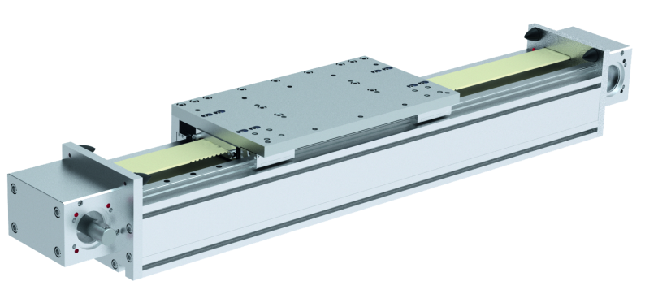
HSB - Gamma
Maximum Rigidity for high Masses

Slide 3
HSB - Gamma
Unique Selling Points | Your Added Value
High basic loads for self-supporting constructions (closed basic profile for maximum rigidity) Rail clamping element with parking brake for level control available Consistent modular design, therefore easy configuration according to customer specification possible. Graduated product program. Toothed belt drive or rack and pinion drive on option. Double profiled rail guidance | No additional supporting structures are necessary For a higher process reliability and protection of the system/plant Minimal time expenditure during construction and project engineering Due to optimum sizes, selectable for every application (no oversizing) For a high load capacity and precision

Slide 4
HSB - Gamma Einsatzgebiete
Solution | Industries | Example of Application
Toothed belt drive: Efficient axis applications with high requirements to rigidity and dynamic. Very long stroke lengths and high masses can be also implemented with this drive system. Rack and pinion drive: Axis application, where several slides on one axis profile can be separately controlled. Very long stroke lengths and high masses can be also implemented with this drive system. | Machinining Automotive industry Solar industry | Interlinking of several machine tools for loading and unloading

Slide 5
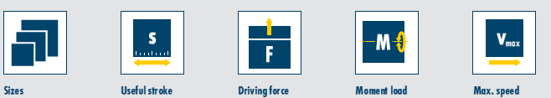
HSB - Gamma Technical Specifications
Number of profile sizes: 4 Drive: Toothed belts or rack Guidance: Profiled rail guidance Material of the profile: Aluminum, natural anodized
Rack
120 … 280
bis 11.520 mm
bis 7.500 N
bis 16.000 Nm
5 m/s
Belt drive
120 … 280
bis 11.520 mm
bis 10.000 N
bis 15.000 Nm
5 m/s

Slide 6
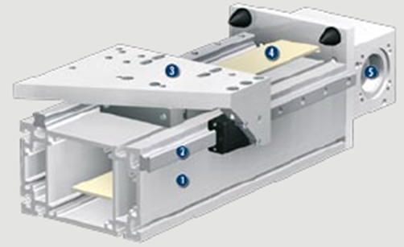
HSB - Gamma Principle of Function
Sectional Diagram
Axis body as a beam profile
Profiled rail guidance
Carriages
Drive: toothed belts
Interface for drive unit

Slide 7
...bietet mehr...
...offers more...

