Slide 1

Product presentation
Beta
Linear axis

Slide 2
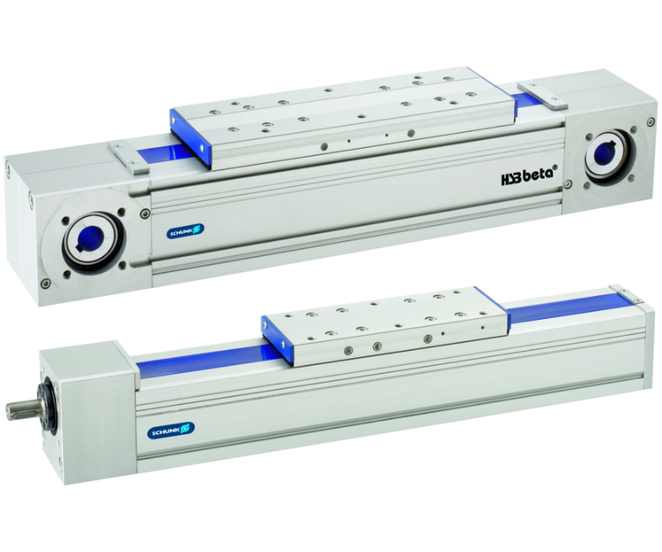
Linear axis
Universal linear module with optional toothed belt or spindle drive and various guiding options
The most comprehensive modular system for linear axes.
22 profile sizes are selectable

Slide 3

Flexible. Modular. Compact.
New Beta ZSE variant as a cost-effective standard solution
Defined scope of functions and variants for fast delivery and competitive price
Proven Beta ZSS technology
Available in sizes 60, 80 and 110

Slide 4
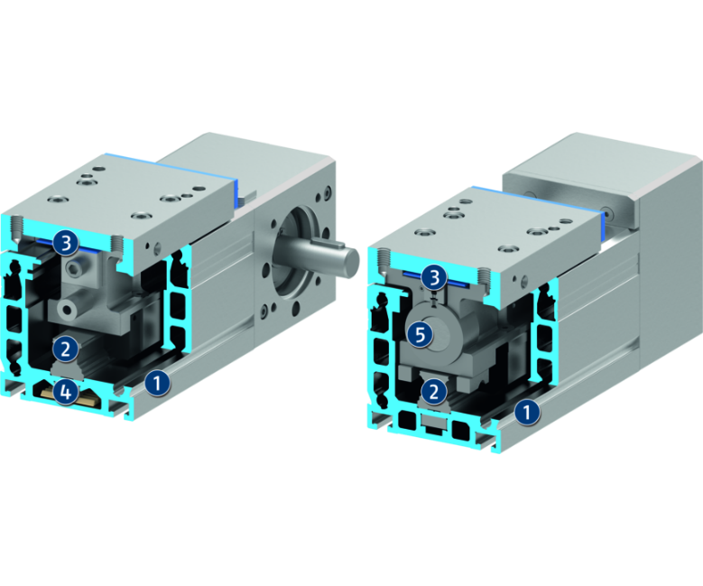
Principle of function
Functional description
The slide is driven by a toothed belt or a ball screw spindle and precisely guided by a (double) profiled rail guide. The cover band runs through the slide and covers the drive and guidance. The servomotor is usually connected to the profile via the drive shaft.
1
Aluminum profile
2
Profiled rail guide
3
Covering tape made of plastic
4
Toothed belt
5
Ball screw spindle

Slide 5
Advantages – Your benefits
Adaptable drive motor for versatile approach and easy integration into existing control concepts
Optional belt or spindle driven for the optimum drive for your application
Various guide options for optimal adaption to your application
Cost-effective basic version with basic functions for simple and cost-effective applications
Compact dimensions for less interfering contours
Integrated cover tape for versatility and a long tool life
Fixing via T-nuts or slot nut possible for flexibility in the integration

Slide 6
Technical data
Technical data overview
Size | Max. driving force | Max. stroke | Max. acceleration
 | [N] | [mm] | [m/s²]
40 | 500 .. 1000 | 890 .. 1850 | 20 .. 30
50 | 700 .. 1000 | 860 .. 7710 | 20 .. 30
60 | 750 .. 4000 | 5220 .. 7670 | 20 .. 30
70 | 900 .. 2000 | 3725 .. 7640 | 20 .. 30
80 | 1100 .. 4000 | 5020 .. 7600 | 20 .. 40
100 | 1500 .. 4000 | 5260 .. 7720 | 20 .. 60
110 | 2000 .. 6000 | 5120 .. 7520 | 20 .. 60
120 | 4000 .. 12000 | 5120 .. 7520 | 20 .. 60
140 | 2500 .. 6000 | 4920 .. 7540 | 20 .. 60
165 | 10000 .. 18000 | 5010 .. 6920 | 20 .. 60
180 | 3500 .. 12000 | 5030 .. 5500 | 20 .. 60

