Slide 1

Product presentation
Alpha

Slide 2
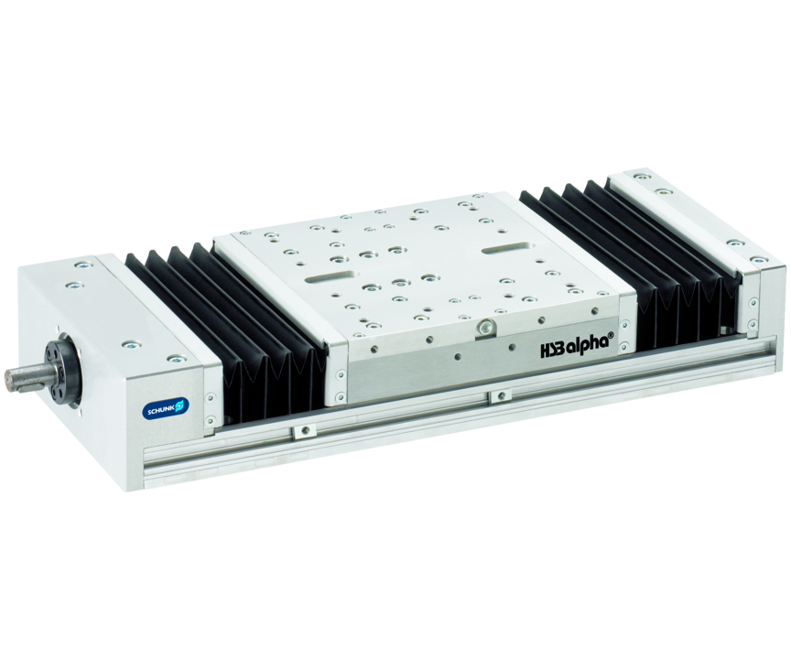
Flat linear table with spindle drive and double-profiled rail guide

Slide 3

Flat. Loadable. Precise.

Slide 4
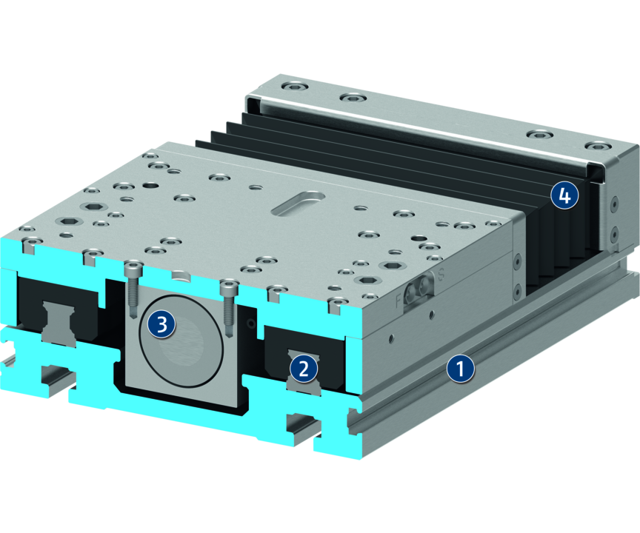
Principle of function
Functional description
The slide is driven by a ball screw spindle and precisely guided by a double profiled rail guide. The bellows cover the spindle and the guidance. The servomotor is connected to the profile via the drive shaft.
1
Aluminum profile
2
Profiled rail guide
3
Spindle
4
Bellows cover

Slide 5
Advantages – Your benefits
Adaptable drive motor for versatile approach and easy integration into existing control concepts
Double-profiled rail guide for very high force and moment loads
Extremely flat design for minimal interfering contours
Integrated bellows cover for versatility and a long tool life
Machined stop edge for precise alignment and fastening

Slide 6
Technical data
Technical data overview
Size | Max. driving force | Max. stroke | Max. acceleration
 | [N] | [mm] | [m/s²]
15 | 4000 | 971 | 20
20 | 6000 | 1387 | 20
30 | 12000 | 2224 | 20
35 | 18000 | 2158 | 20

