Slide 1

Product presentation
GSW-V
Vacuum Gripper

Slide 2
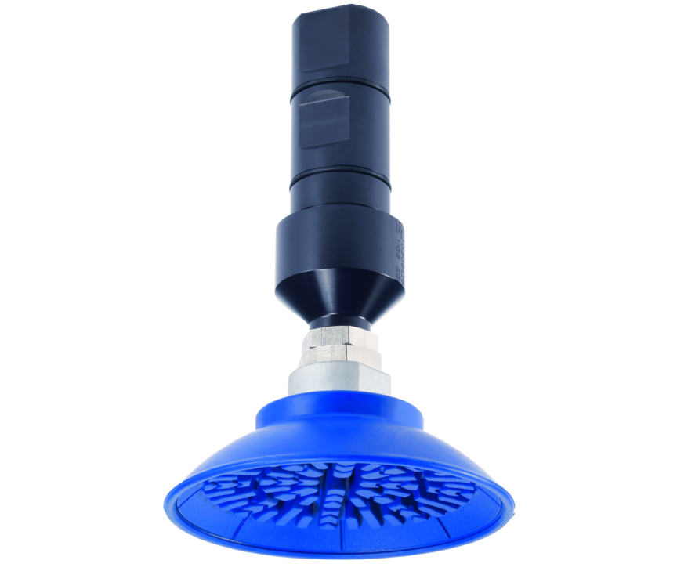
Vacuum Gripper
Vacuum gripper for spindle interfaces for handling flat components
The simplest solution for the integration of suction grippers in the machine tools.
Up to 4.9 kg workpiece weight

Slide 3

Compact. Cost-effective. Productive.

Slide 4
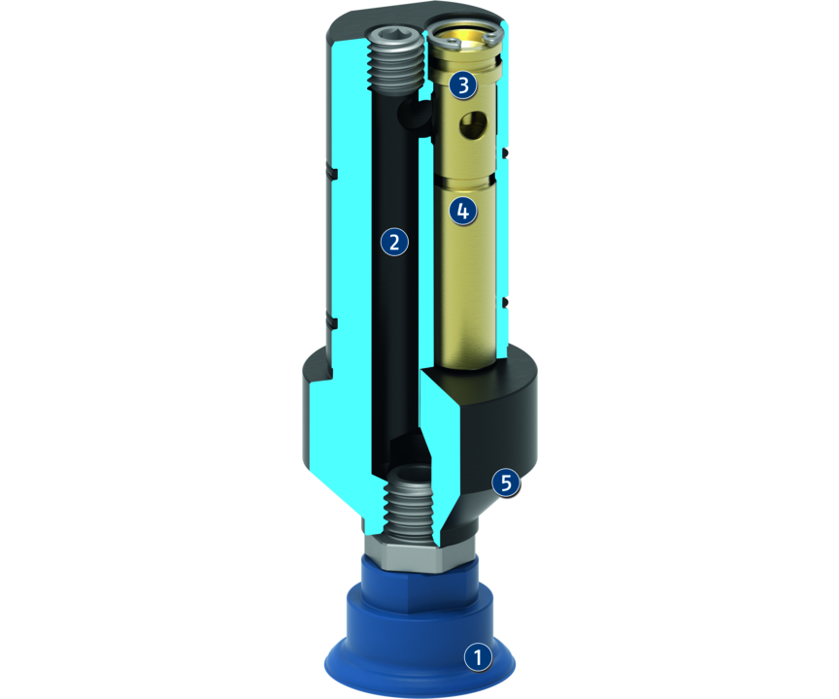
Principle of function
Functional description
The gripper can be used in any machine which provides compressed air or lubricating coolants supply via the toolholder mounting.
The vacuum gripper is equipped with an integrated Venturi nozzle, and therefore does not require a vacuum connection to generate negative pressure.
During the gripping operation the gripper continuously supplies coolant or compressed air.
1
Vacuum suction cup
2
Intake duct
3
Media supply
4
Venturi nozzle
5
Outlet opening

Slide 5
Advantages – Your benefits
Low-cost module for flexible automation in your machine
Fast, automated gripper changeover from the gripper to the storage rack
Fully automated workpiece changeover without robot or gantry system
Universally suitable for many different workpieces

Slide 6
Technical data
Technical data overview
Size | Weight | Recommended workpiece weight | Suction force | Max. permissible speed | Nominal operating pressure compressed air | Nominal operating pressure coolant
 | [kg] | [kg] | [N] | [1/min] | [bar] | [bar]
20 | 0.12 .. 0.28 | 0.28 .. 4.9 | 55 .. 980 | 20 | 6 | 40
25 | 0.15 .. 0.31 | 0.28 .. 4.9 | 55 .. 980 | 20 | 6 | 40
32 | 0.23 .. 0.39 | 0.28 .. 4.9 | 55 .. 980 | 20 | 6 | 40

