Slide 1

Product presentation
GSW-B
Gripper with shaft interface

Slide 2
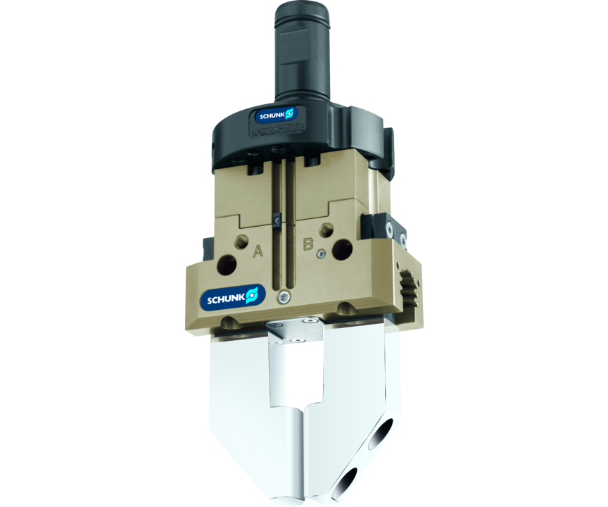
Gripper with shaft interface
Universal gripper PGN-plus/PZN-plus with GSW-B shank interface
The simplest solution for the integration of SCHUNK grippers in the machine tools.
Up to 1,740 N gripping force

Slide 3

High flow rate. Cost-effective. Powerful.

Slide 4
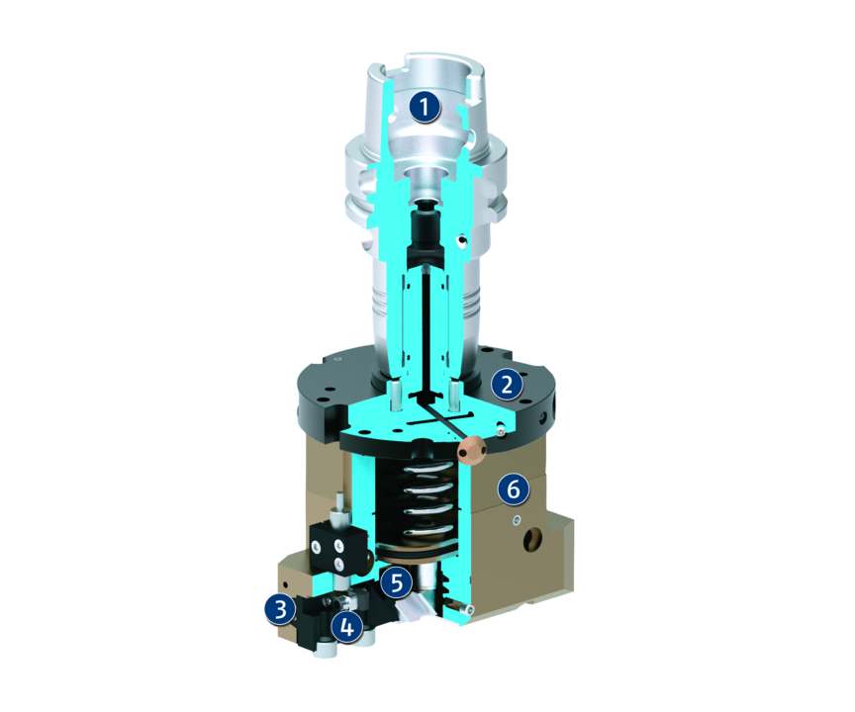
Principle of function
Functional description
The pressure generated by the central machine coolant supply is reduced by the pressure distributor, which is integrated in the adapter plates. The gripper can then be actuated and can actuate the base jaws correspondingly via the piston and wedge hook.
During the gripping operation the gripper continuously supplies coolant or compressed air via the lateral pressure control valve.
1
Mounting
2
Adapter plate with integrated pressure distributor
3
Multi-tooth guidance
4
Base Jaw
5
Wedge-hook design
6
Housing

Slide 5
Advantages – Your benefits
Low-cost module from a universal gripper PGN-plus/PZN-plus and a shank interface
Fast, automated gripper changeover from the gripper to the storage rack
Fully automated workpiece changeover without robot or gantry system

Slide 6
Technical data
Technical data overview
Size | Weight | Max. permissible speed | Nominal operating pressure compressed air | Nominal operating pressure coolant
 | [kg] | [1/min] | [bar] | [bar]
50 | 0.2 | 20 | 6 | 40
64 | 0.23 | 20 | 6 | 40
80 | 0.31 | 20 | 6 | 40
100 | 0.42 | 20 | 6 | 40

