Slide 1

Product presentation
ORG
O-ring assembling gripper

Slide 2
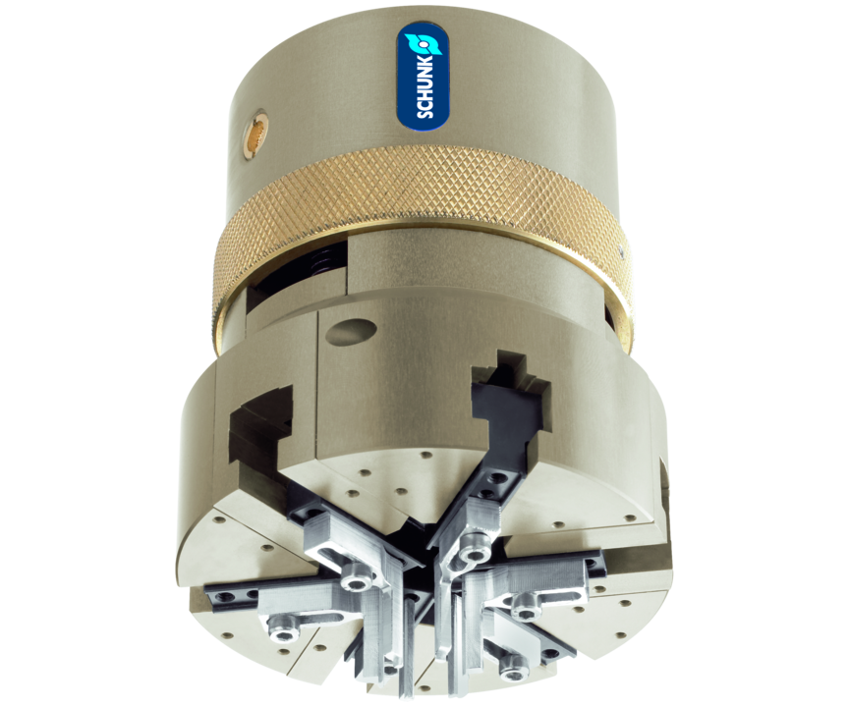
O-ring assembling gripper
Grippers, attached with appropriate top fingers allows assembly of O-rings, including square rings and others both on shafts (external assembly) and in bores (internal assembly)

Slide 3

Reliable. Flexible. Productive.

Slide 4
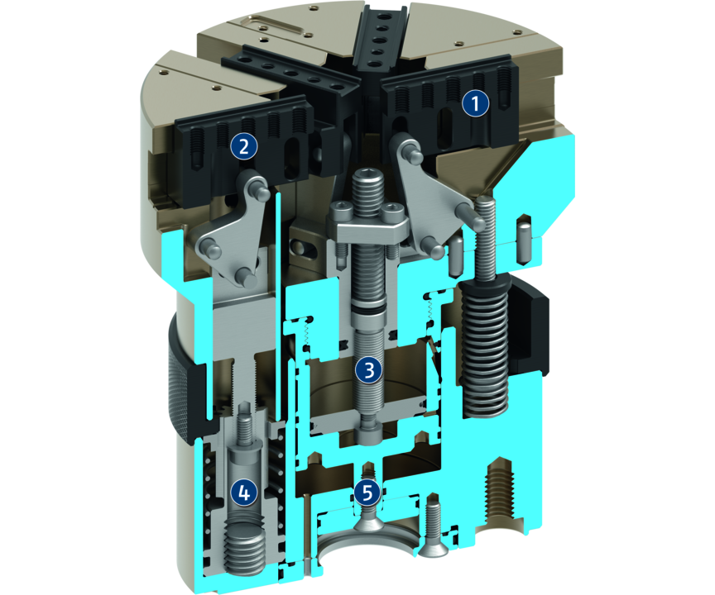
Principle of function
Functional description
External assembly
The O-ring is expanded by all six fingers, then the gripper is moved to the assembly groove on the shaft. First the three fingers of triple jaws A are retracted with the linear travel.
The O-ring is fit through the triangle shape, which adjusts to the remaining hold of the three fingers of triple jaws B, already partially in the groove. The entire gripper is now retracted. The O-ring is now forced completely into its assembly groove.
Internal assembly
1
Triple jaw A
2
Triple jaw B
3
Drive
4
Drive
5
Drive

Slide 5
Advantages – Your benefits
O.D. and I.D. assembly with one gripper for flexibility and cost-saving
Reliable performance due to new mounting principle for high availability
Standard assembly finger for O.D. assembly for conventional ring sizes for fast commissioning

Slide 6
Technical data
Technical data overview
Size | Number of fingers | Closing time | Opening time | Weight | Max. permissible finger length
 |  | [s] | [s] | [kg] | [mm]
85 | 6 | 0.1 | 0.12 | 1.35 | 80

