Slide 1

Product presentation
GSM-P
Parallel Gripper Swivel Module

Slide 2
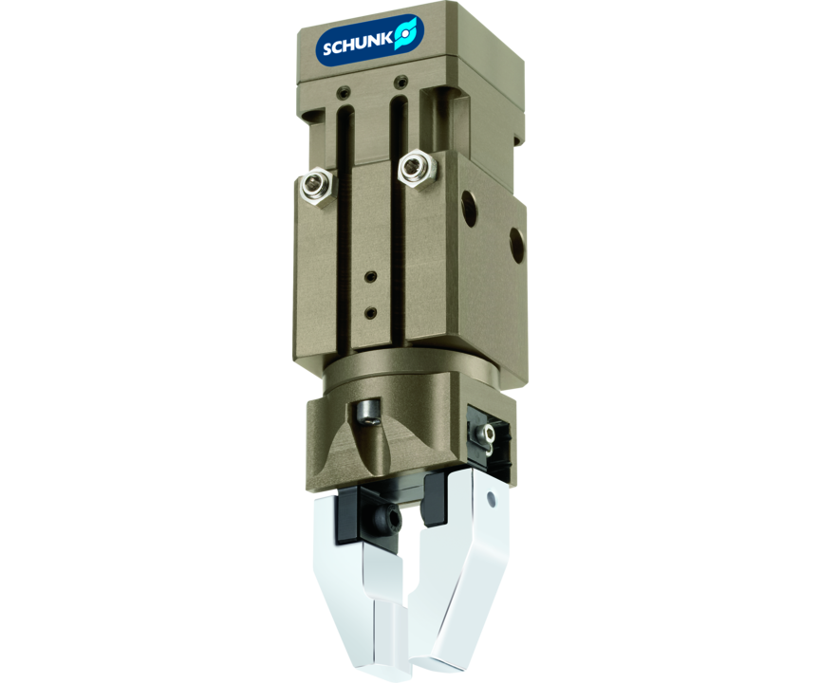
Parallel Gripper Swivel Module
Compact gripper swivel combination, consisting of a powerful rotor drive, an end position and damping device as well as a 2-finger parallel gripper.
Only 0.37 kg weight

Slide 3

Flexible. Energy-efficient. Compact.

Slide 4
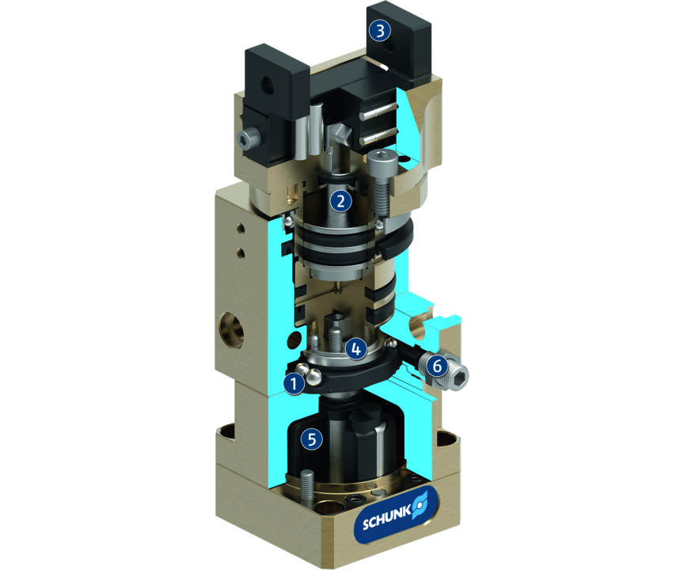
Principle of function
Functional description
The swivel drive rotates the integrated gripper by applying pressure from a rotor. It is driven by its own piston. The piston motion is subsequently transformed into a synchronized gripping motion.
1
Pre-adjustment of rotating angle
2
Gripper drive
3
Base Jaw
4
Stop damping assembly
5
Vane swivel unit
6
Hydraulic shock absorber

Slide 5
Advantages – Your benefits
Space-saving as the rotary drive, end-position damping unit and gripper are merged in one compact module
Cost-saving due to the omission of adapter plates and the costs associated with project planning, and engineering design
Powerful for even greater masses and inertias due to the variant with hydraulic shock absorbers
Flexible through several mounting options, infinitely adjustable swiveling angle and numerous product versions
Cross roller guidance for precise gripping through due to a scope-free base jaw guidance
Process reliable as moving cables and hoses are replaced by integrated feed-throughs
Mounting on three gripper sides in five screwing directions for universal and flexible assembly of the gripper swivel module
Air supply via hose-free direct connection or screw connections for the specific adaption of the gripper swivel module in all automation solutions
Comprehensive accessories due to the use of existing gripper components

Slide 6
Technical data
Technical data overview
Size | Stroke per jaw | Closing force | Opening force | Torque | Angle of rotation | Recommended workpiece weight | Weight | Max. permissible finger length
 | [mm] | [N] | [N] | [Nm] | [°] | [kg] | [kg] | [mm]
32 | 4 | 39 .. 51 | 33 .. 48 | 0.35 | 90 .. 180 | 0.2 | 0.37 .. 0.42 | 32
40 | 6 | 66 .. 87 | 54 .. 69 | 0.3 | 90 .. 180 | 0.33 | 0.43 .. 0.5 | 40
50 | 8 | 105 .. 135 | 93 .. 114 | 2.9 | 90 .. 180 | 0.52 | 1.19 .. 1.2 | 50
64 | 10 | 120 .. 162 | 114 .. 147 | 2.7 | 90 .. 180 | 0.61 | 1.39 .. 1.51 | 64

