Slide 1

Product presentation
DRG
Sealed gripper

Slide 2
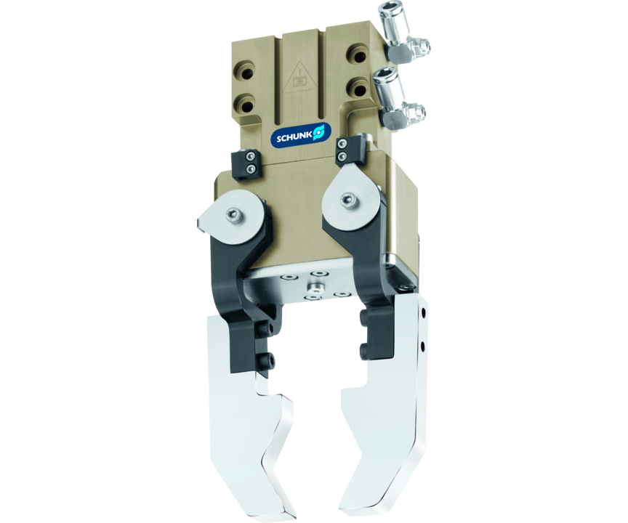
Sealed gripper
Sealed 180° angular gripper for the use in contaminated environments

Slide 3

Fully encapsulated. Narrower. More flexible.

Slide 4
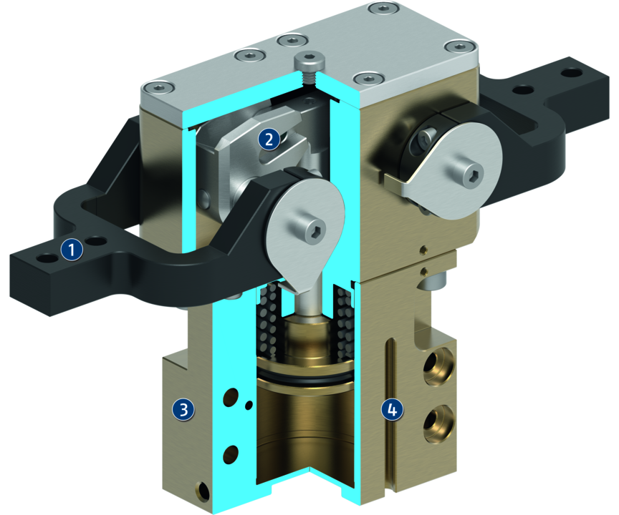
Principle of function
Functional description
The round piston is pushed upwards or downwards with compressed air.
In the process, the two pins of the slotted link gear move in unison and relative to the groove in the top jaws. In the gripping moment, these two pins reach the largest lever arm.
1
Base fingers
2
Kinematics
3
Housing
4
Position monitoring

Slide 5
Advantages – Your benefits
Completely sealed gripper version allows applications in dirty environments
Air supply via hose-free direct connection or screw connections for flexible pressure supply in all automated systems
Equipped with gripping force maintenance device ensuring that the workpiece stays gripped in case of power drop
Opening angle adjustable from 20° to 180° for a versatile field of applications
Kinematics Slotted link gear for centric gripping with large opening/closing movements

Slide 6
Technical data
Technical data overview
Size | Opening angle per jaw | Max. permissible finger length
 | [°] | [mm]
44 | 90 | 50
54 | 90 | 60
64 | 90 | 80
80 | 90 | 100
100 | 90 | 125

