Slide 1

Product presentation
PRG
Universal gripper

Slide 2
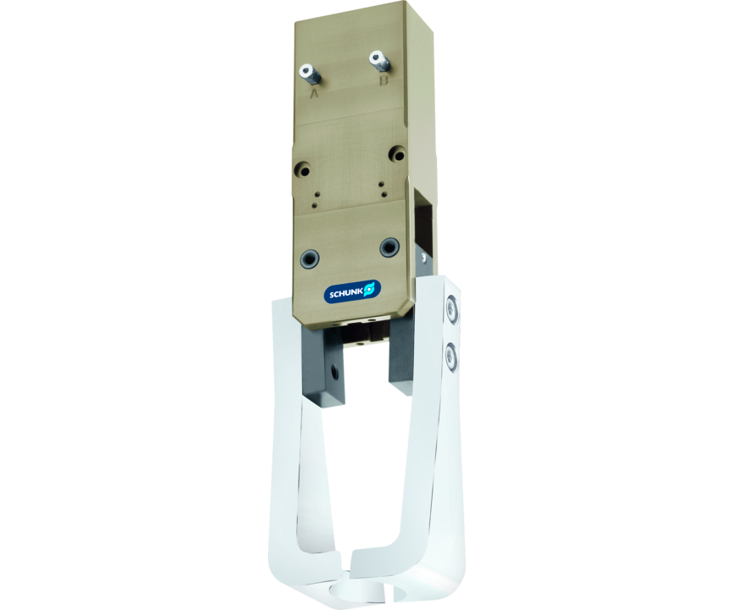
Universal gripper
180° radial gripper with powerful 1-shift slotted link gear and oval piston
The most powerful pneumatic radial gripper with 180° opening angle on the market.
Up to 295 Nm closing moment

Slide 3

Flexible. Powerful. Slim.

Slide 4
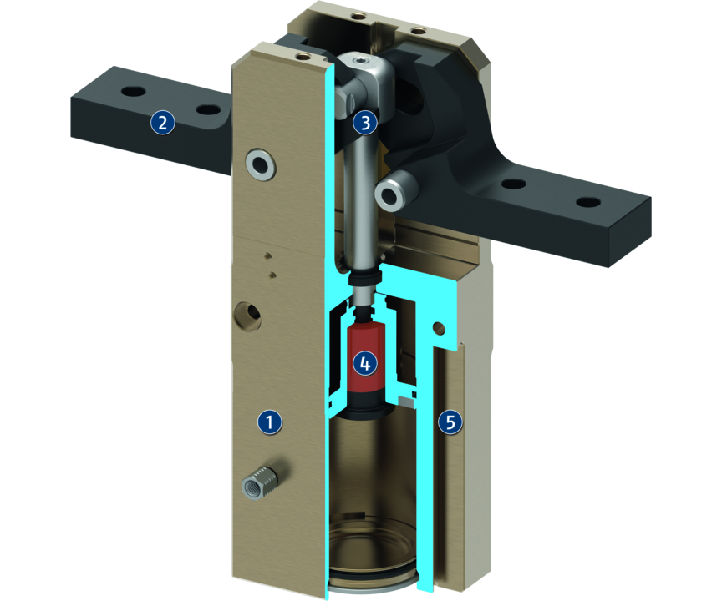
Principle of function
Functional description
The patented “1-pin link guide” converts the movement into a powerful closing torque. The closing moment is additionally reinforced by the curved shape of the guidance.
In addition to a rapid stroke behaviour the slotted link also assures a nearly constant closing torque over a large closing angle range.
1
Housing
2
Base Jaw
3
Kinematics
4
Damping
5
Monitoring

Slide 5
Advantages – Your benefits
Kinematics the 1-shift slotted link gear assures a consistant closing moment from -5° to +7°.
Optimized cycle time due to innovative damping directly integrated drive chain
Maximum compact performance for higher closing moments, longer and stable gripper fingers
Many options ensure a higher degree of flexibility adjusted to the individual application, the PRG is also available with a mechanic gripping force maintenance, as a high-temperature version, and with three opening angle versions 30°/60°/90°.
Air supply via hose-free direct connection or screw connections for flexible pressure supply in all automated systems

Slide 6
Technical data
Technical data overview
Size | Opening angle per jaw | Max. permissible finger length
 | [°] | [mm]
26 | 30 .. 90 | 40
34 | 30 .. 90 | 60
42 | 30 .. 90 | 80
52 | 30 .. 90 | 100
64 | 30 .. 90 | 125
80 | 30 .. 90 | 160
100 | 30 .. 90 | 200
125 | 30 .. 90 | 240

