Slide 1

Product presentation
SGW
Angular Gripper for small components

Slide 2
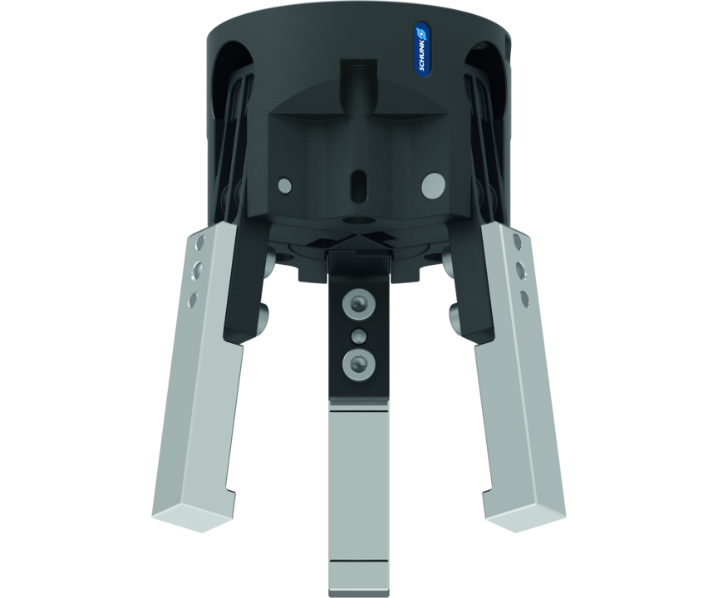
Angular Gripper for small components
Small, simple pressurized plastic angular gripper with spring return

Slide 3

Light. Fast. Flexible.

Slide 4
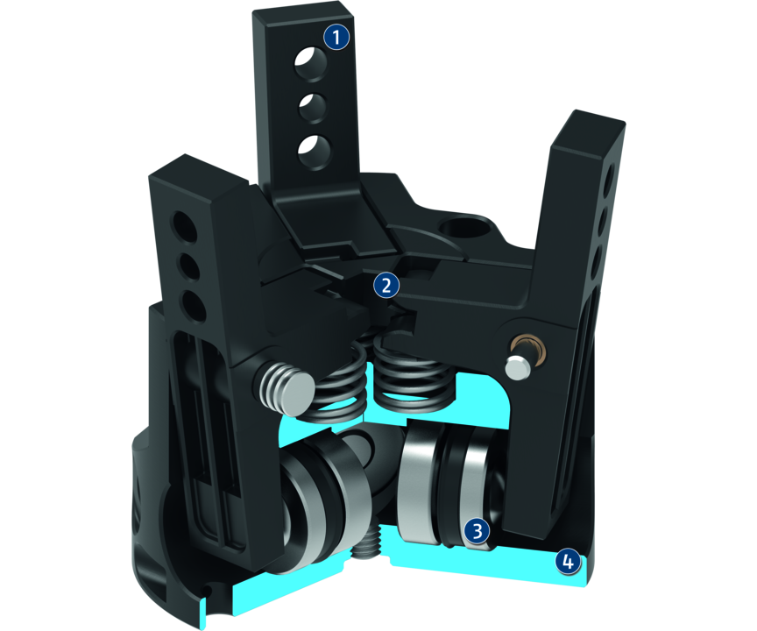
Principle of function
Functional description
The horizontally arranged pistons are pressed away from each other by compressed air.
The base jaws are opened at an angle and in a synchronized fashion by the bearing-mounted lever mechanism.
Reset is done by compression spring.
1
Base Jaw
2
Lever mechanism
3
Drive
4
Housing

Slide 5
Advantages – Your benefits
Housing made of plastic Making the gripper extremely light and free from corrosion
One-way acting 3-fold piston with lever gear for high power transmission and synchronized gripping
Spring-loaded pressure piece for optional pressing and separating of workpieces
favorable in price especially suitable for low-budget applications

Slide 6
Technical data
Technical data overview
Size | Recommended workpiece weight | Weight | Max. permissible finger length
 | [kg] | [kg] | [mm]
40 | 0.3 | 0.05 | 32
50 | 0.6 | 0.09 | 40
64 | 1.3 | 0.17 | 50

