Slide 1

Product presentation
SWG
Gripper for small components

Slide 2
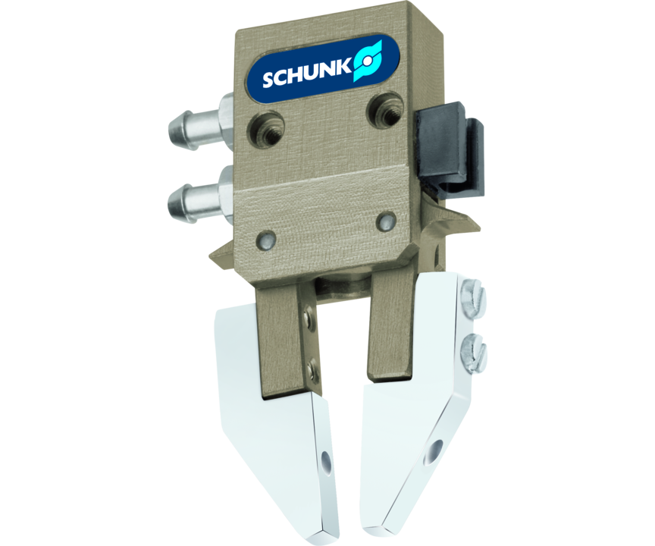
Gripper for small components
Narrow double-acting 2-finger angular gripper
Low interfering contour due to slim, compact design.
Up to 5 mm narrow

Slide 3

Slim. Reliable. Fast.

Slide 4
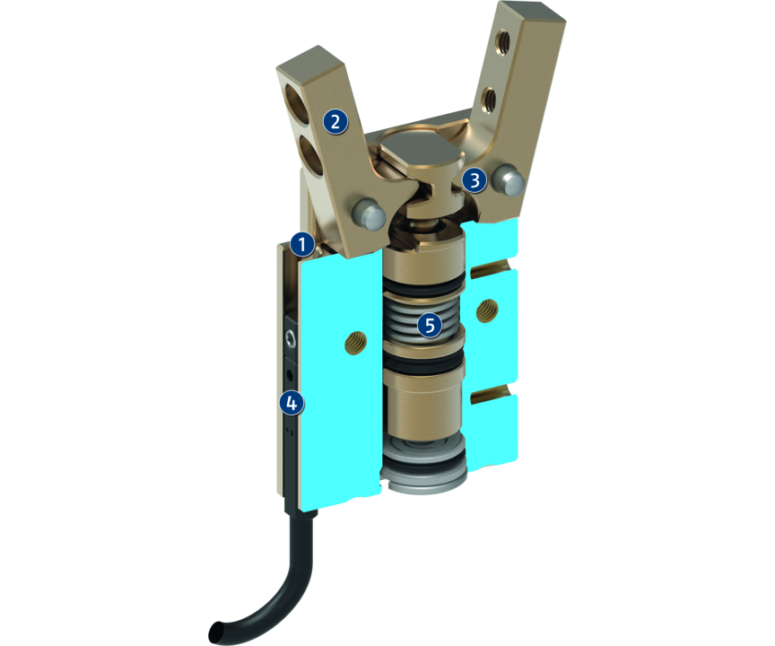
Principle of function
Functional description
The piston is moved up and down by compressed air.
The kinematics transforms this vertical motion into a synchronous and rotatory gripping motion of the base jaws.
1
Housing
2
Base fingers
3
Kinematics
4
Sensor system
5
Gripping force maintenance device

Slide 5
Advantages – Your benefits
Slim design allowing the grippers to be arranged in a row
Spring-supported gripping force maintenance holds the workpiece even in case of a loss of pressure
Wedge-hook design for high power transmission and synchronized gripping
Light and compact design for space-saving handling without interfering contours
Monitoring via electronic magnetic switches a space-saving feature in a slot in the housing

Slide 6
Technical data
Technical data overview
Size | Recommended workpiece weight | Weight | Max. permissible finger length
 | [kg] | [kg] | [mm]
10 | 0.007 | 0.0025 | 10
12 | 0.017 | 0.0048 | 12
16 | 0.027 | 0.011 | 15
20 | 0.043 | 0.019 | 18
25 | 0.09 | 0.035 | 22
32 | 0.156 | 0.069 | 28
40 | 0.24 | 0.106 | 35
50 | 0.46 | 0.213 | 42

