Slide 1

Product presentation
SGB
Angular Gripper for small components

Slide 2
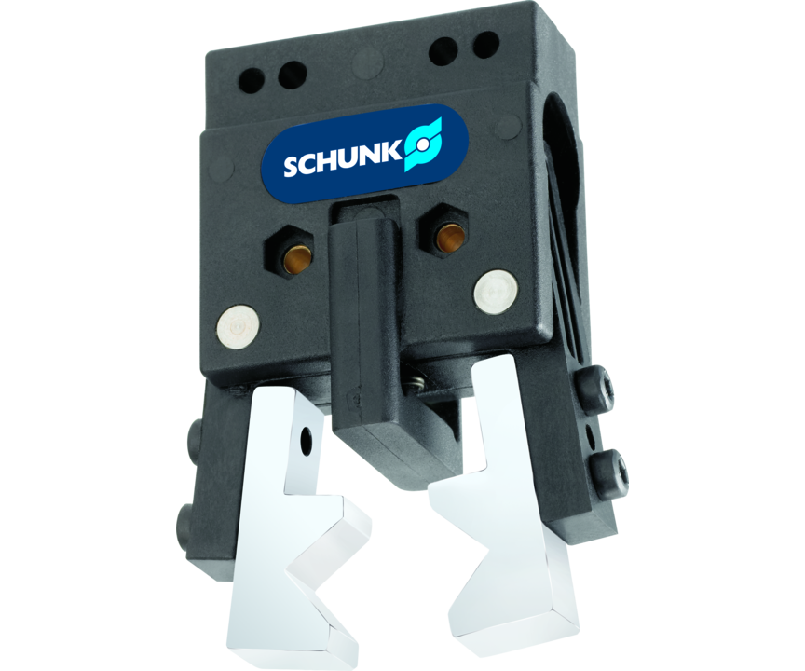
Angular Gripper for small components
Small, simple pressurized plastic angular gripper with spring return

Slide 3

Light. Slim. Fast.

Slide 4
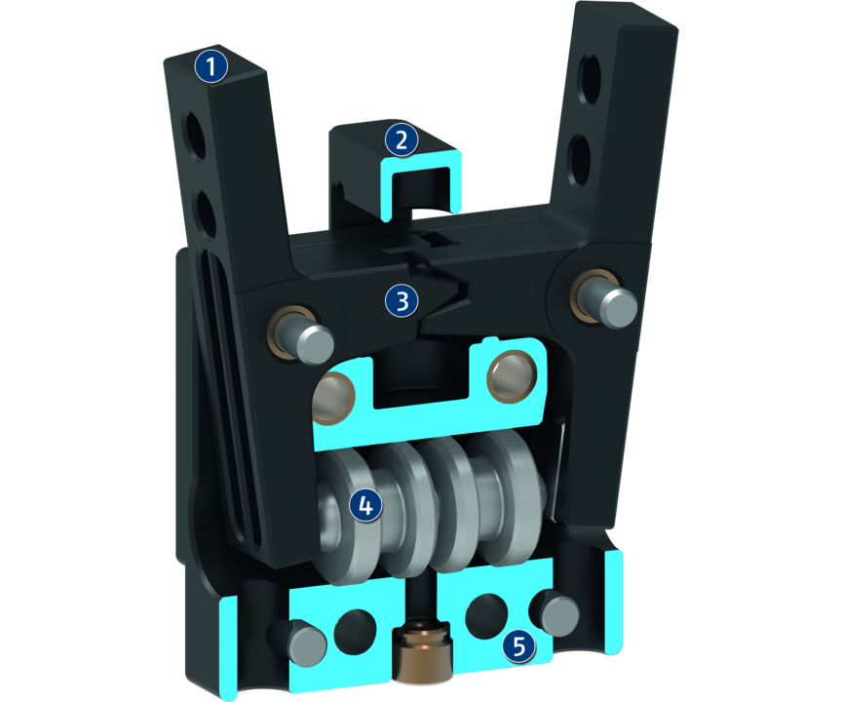
Principle of function
Functional description
The horizontally arranged pistons are pressed away from each other by compressed air.
The base jaws are opened at an angle and in a synchronized fashion by the bearing-mounted lever mechanism.
Reset is done by compression spring.
1
Base Jaw
2
Pressure piece
3
Lever mechanism
4
Drive
5
Housing

Slide 5
Advantages – Your benefits
Housing made from glass fiber reinforced plastic Making the gripper extremely light and free from corrosion
One-way acting double piston drive with lever gear drive for high power transmission and synchronized gripping
Basic version generally equipped with a pressure piece for the spring-supported pressing of workpieces
favorable in price especially suitable for low-budget applications

Slide 6
Technical data
Technical data overview
Size | Recommended workpiece weight | Weight | Max. permissible finger length
 | [kg] | [kg] | [mm]
32 | 0.2 | 0.04 | 32
40 | 0.4 | 0.05 | 40
50 | 0.8 | 0.06 | 50

