Slide 1

Product presentation
PZV
4-finger centric gripper

Slide 2
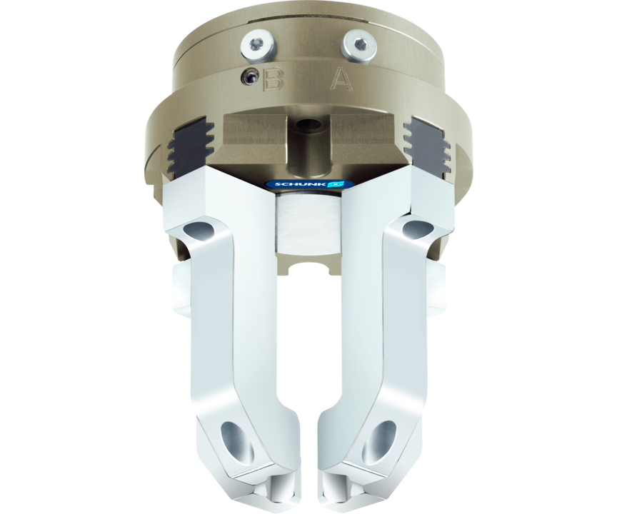
4-finger centric gripper
The multi-finger gripper for applications, in which two or three fingers are insufficient

Slide 3

Loadable. Precise. Reliable.

Slide 4
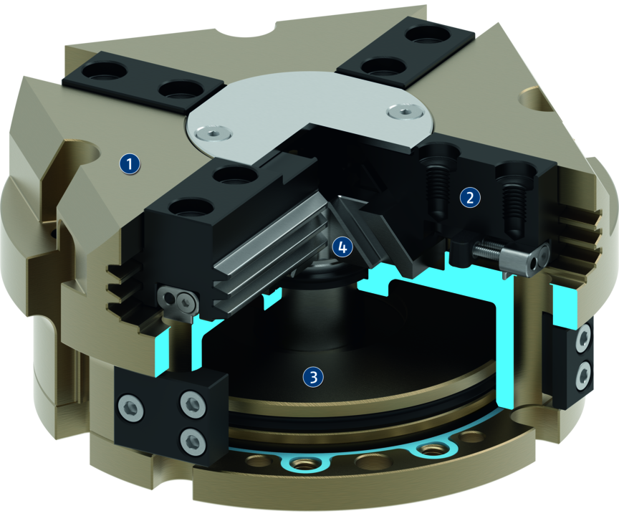
Principle of function
Functional description
The piston is moved up and down by compressed air.
The angled active surfaces of the wedge-hook produce a synchronized, centric jaw movement.
1
Housing
2
Multi-tooth guidance
3
Drive
4
Wedge-hook design

Slide 5
Advantages – Your benefits
Robust multi-tooth guidance for precise handling
Wedge-hook design for high power transmission and synchronized gripping
Air supply via hose-free direct connection or screw connections for flexible pressure supply in all automated systems
Comprehensive sensor accessory program for versatile querying possibilities and stroke position monitoring

Slide 6
Technical data
Technical data overview
Size | Stroke per jaw | Closing force | Opening force | Recommended workpiece weight | Weight | Max. permissible finger length
 | [mm] | [N] | [N] | [kg] | [kg] | [mm]
64 | 4 | 570 | 630 | 2.8 | 0.5 | 64
100 | 8 | 1800 | 1900 | 9 | 1.6 | 80
125 | 10 | 3000 | 3230 | 15 | 2.3 | 100
160 | 13 | 5200 | 5600 | 26 | 5.5 | 120
200 | 16 | 6900 | 7300 | 34.5 | 10 | 140

