Slide 1

Product presentation
DPZ-plus
Sealed gripper

Slide 2
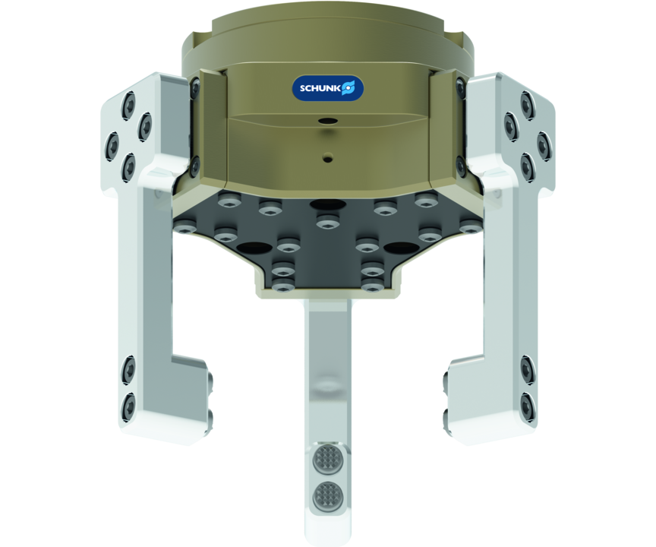
Sealed gripper
Despite the high moment load of the base jaws, this sealed 3-finger centric gripper meets the requirements of IP67 and does not permit the ingress of any substances from the working environment into the interior of the component.

Slide 3

Fully encapsulated. Reliable. Precise.

Slide 4
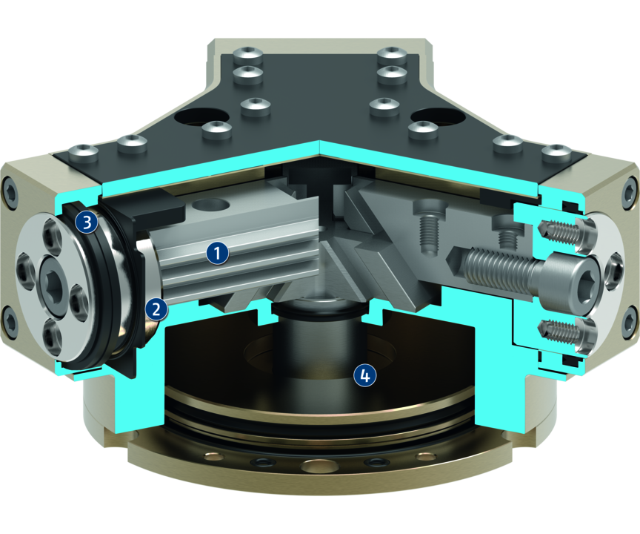
Principle of function
Functional description
The piston is moved up and down by compressed air.
The angled active surfaces of the wedge-hook produce a synchronized, centric jaw movement.
1
Inner base jaw with multi-tooth guidance
2
External round base jaw
3
Lip seal
4
Round piston with rod and wedge-hook

Slide 5
Advantages – Your benefits
Robust interior multi-tooth guidance for the precise handling of different workpieces
Lip seal at the outside round guidance for permanent, secure gripper sealing
High maximum moments possible suitable for using long gripper fingers
Sealed 3-finger centric gripper complies to IP67 requirements despite a high moment load
Fastening at one gripper side in two screw directions for universal and flexible gripper assembly
Maximum gripping forces at a compact design for a wide range of applications
Air supply via hose-free direct connection or screw connections for flexible pressure supply in all automated systems
Compact dimensions for minimal interfering contours in handling

Slide 6
Technical data
Technical data overview
Size | Stroke per jaw | Closing force | Opening force | Recommended workpiece weight | Weight | Max. permissible finger length
 | [mm] | [N] | [N] | [kg] | [kg] | [mm]
40 | 2.5 | 230 .. 320 | 250 .. 355 | 1.15 | 0.2 .. 0.25 | 30 .. 40
50 | 2 .. 4 | 290 .. 830 | 320 .. 945 | 1.45 .. 3.06 | 0.37 .. 0.45 | 30 .. 50
64 | 3 .. 6 | 520 .. 1215 | 620 .. 1490 | 2.6 .. 4.6 | 0.62 .. 0.92 | 40 .. 64
80 | 4 .. 8 | 900 .. 2725 | 1000 .. 2765 | 4.5 .. 10.35 | 1.3 .. 1.6 | 50 .. 80
100 | 5 .. 10 | 1620 .. 4950 | 1920 .. 5460 | 8.1 .. 18 | 1.9 .. 2.3 | 64 .. 100
125 | 6 .. 13 | 2945 .. 7000 | 3000 .. 8300 | 14.7 .. 27.5 | 3.5 .. 4.7 | 80 .. 125
160 | 8 .. 16 | 5700 .. 14260 | 5880 .. 15070 | 28.5 .. 52 | 7.9 .. 9.7 | 80 .. 125
200 | 14 .. 25 | 6750 .. 16500 | 7160 .. 17150 | 33.5 .. 60 | 15.6 .. 20.1 | 100 .. 160

