Slide 1

Product presentation
JGZ
Universal gripper

Slide 2
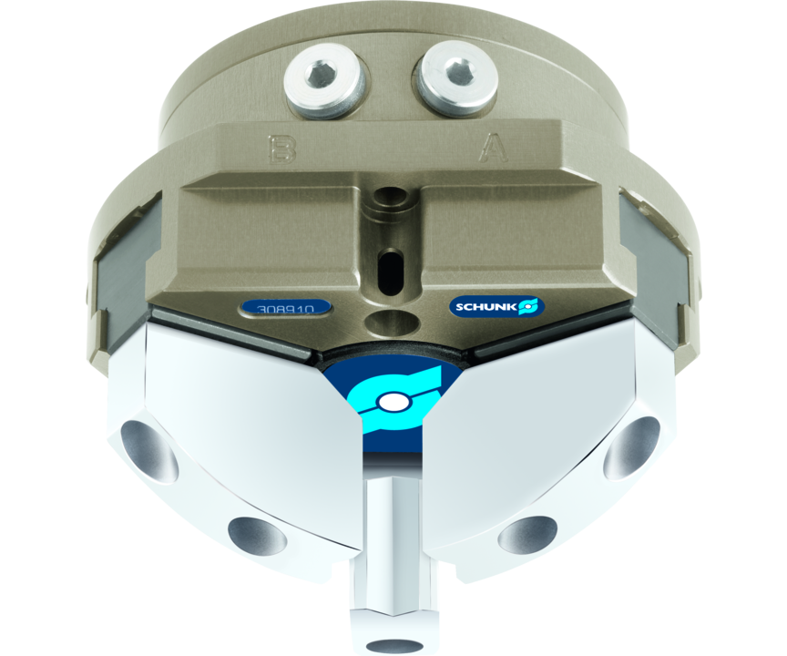
Universal gripper
Universal 3-finger centric gripper of the compact class with T-slot guidance and best cost-performance ratio

Slide 3

Loadable. Reliable. Compact.

Slide 4
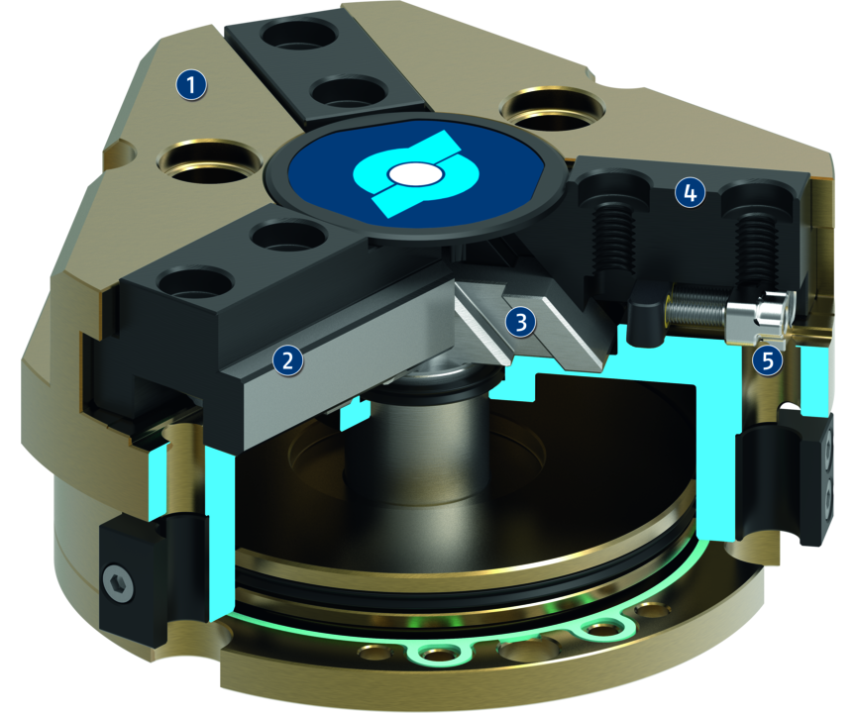
Principle of function
Functional description
The piston is moved up and down by compressed air.
The angled active surfaces of the wedge-hook produce a synchronized, centric jaw movement.
1
Housing
2
T-slot guidance
3
Wedge-hook design
4
Base Jaw
5
Sensor system

Slide 5
Advantages – Your benefits
A firm focus on the essentials for maximum profitability
Sturdy T-slot guidance for the precise handling of different workpieces
Compact dimensions and low weight for minimal interfering contours in handling
High maximum moments possible suitable for using long gripper fingers
Wedge-hook design for high power transmission and synchronized gripping
Comprehensive sensor accessories for monitoring and control of the stroke position
Fastening at one gripper side in two screw directions for universal and flexible gripper assembly
Air supply via hose-free direct connection or screw connections for flexible pressure supply in all automated systems

Slide 6
Technical data
Technical data overview
Size | Stroke per jaw | Closing force | Opening force | Recommended workpiece weight | Weight | Max. permissible finger length
 | [mm] | [N] | [N] | [kg] | [kg] | [mm]
40 | 2.5 | 255 .. 355 | 270 .. 370 | 1.25 | 0.12 .. 0.15 | 45 .. 50
50 | 4 | 325 .. 445 | 355 .. 505 | 1.6 | 0.25 .. 0.3 | 58 .. 64
64 | 6 | 580 .. 765 | 640 .. 860 | 2.9 | 0.43 .. 0.54 | 72 .. 80
80 | 8 | 1000 .. 1350 | 1080 .. 1450 | 5 | 0.79 .. 0.96 | 90 .. 100
100 | 10 | 1800 .. 2520 | 1920 .. 2700 | 9 | 1.41 .. 1.95 | 115 .. 125
125 | 13 | 3100 .. 4150 | 3330 .. 4400 | 15.5 | 2.8 .. 3.6 | 145 .. 160
160 | 16 | 6000 .. 7990 | 6390 .. 8480 | 30 | 5.6 .. 8 | 180 .. 200

