Slide 1

Product presentation
PZN-plus
Universal gripper

Slide 2
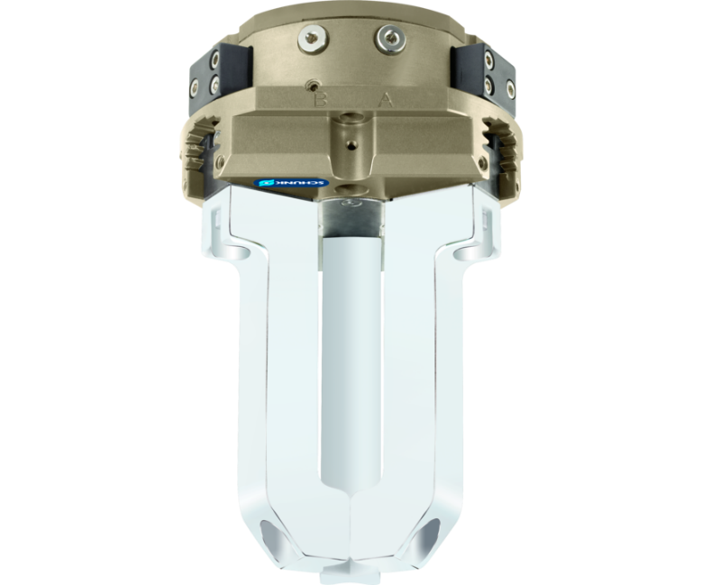
Universal gripper
Universal 3-finger centric gripper with high gripping force and maximum moments due to multi-tooth guidance

Slide 3

Reliable. Robust. Flexible.

Slide 4
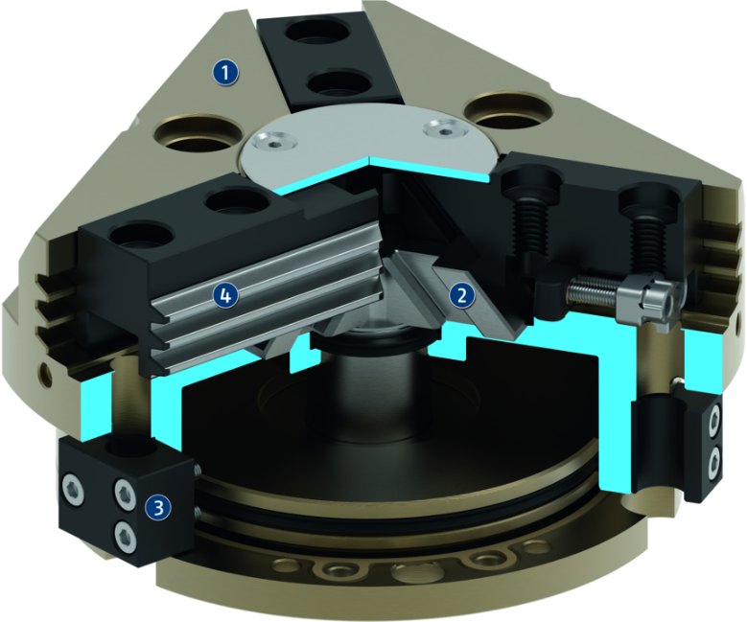
Principle of function
Functional description
The piston is moved up and down by compressed air.
The angled active surfaces of the wedge-hook produce a synchronized, centric jaw movement.
1
Housing
2
Wedge-hook design
3
Sensor system
4
Multi-tooth guidance

Slide 5
Advantages – Your benefits
Robust multi-tooth guidance for precise handling
High maximum moments possible suitable for using long gripper fingers
Wedge-hook design for high power transmission and synchronized gripping
Air supply via hose-free direct connection or screw connections for flexible pressure supply in all automated systems
Comprehensive sensor accessory program for versatile querying possibilities and stroke position monitoring
Manifold options for special optimization for your specific case of application (dustproof, high-temperature, corrosion-protected, etc.)
Fastening at one gripper side in two screw directions for universal and flexible gripper assembly

Slide 6
Technical data
Technical data overview
Size | Stroke per jaw | Closing force | Opening force | Weight | Recommended workpiece weight | Max. permissible finger length
 | [mm] | [N] | [N] | [kg] | [kg] | [mm]
40 | 2.5 | 255 .. 446 | 270 .. 463 | 0.13 .. 0.21 | 1.3 | 40 .. 58
50 | 2 .. 4 | 325 .. 970 | 355 .. 1050 | 0.27 .. 0.46 | 1.65 .. 3.4 | 50 .. 72
64 | 3 .. 6 | 580 .. 1585 | 640 .. 1833 | 0.43 .. 0.8 | 2.9 .. 5.5 | 64 .. 90
80 | 4 .. 8 | 1000 .. 3866 | 1080 .. 4182 | 0.79 .. 1.4 | 5 .. 11.5 | 80 .. 110
100 | 5 .. 10 | 1800 .. 6493 | 1920 .. 7274 | 1.41 .. 2.7 | 9 .. 20 | 80 .. 145
125 | 6 .. 13 | 3100 .. 9674 | 3330 .. 10489 | 2.47 .. 4.5 | 15.5 .. 29 | 100 .. 180
160 | 8 .. 16 | 6000 .. 18229 | 6390 .. 19796 | 5.6 .. 9.6 | 30 .. 55 | 100 .. 220
200 | 14 .. 25 | 7100 .. 17380 | 7540 .. 18330 | 11 .. 16.7 | 35.5 .. 63.5 | 200 .. 280
240 | 17 .. 30 | 9500 .. 26500 | 10400 .. 28000 | 20 .. 25.5 | 50 .. 100.5 | 200 .. 300
300 | 20 .. 35 | 14500 .. 35500 | 15200 .. 37300 | 33 .. 46 | 72.5 .. 127.5 | 200 .. 250
380 | 26 .. 45 | 24400 .. 57300 | 25500 .. 59500 | 64 .. 80 | 122 .. 227 | 200 .. 250

