Slide 1

Product presentation
MPZ
Gripper for small components

Slide 2
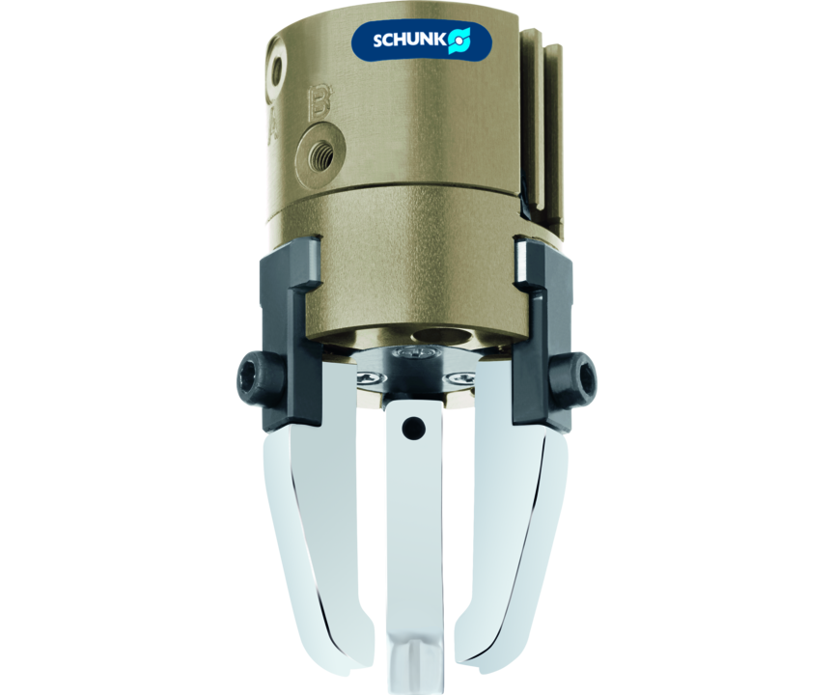
Gripper for small components
Small 3-finger centric gripper with base jaws guided on T-slots

Slide 3

Precise. Compact. Reliable.

Slide 4
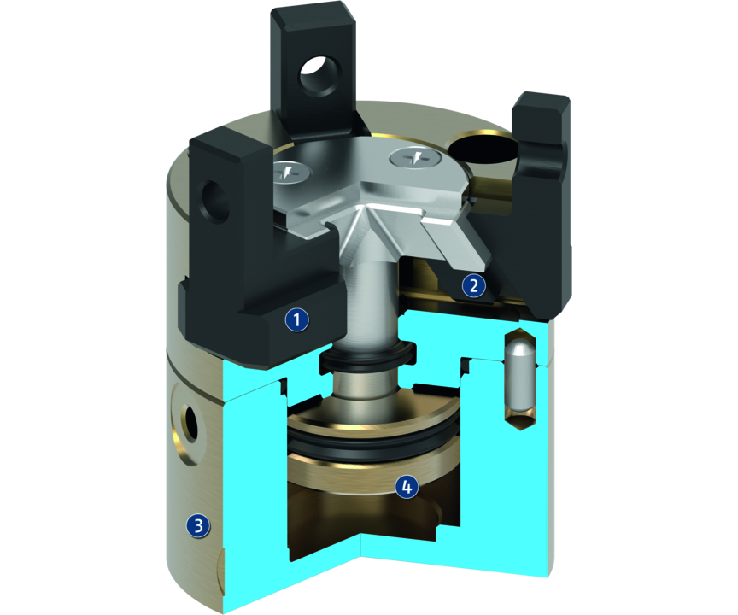
Principle of function
Functional description
The piston is moved up and down by compressed air.
The angled active surfaces of the wedge-hook produce a synchronized, centric jaw movement.
1
T-slot guidance
2
Wedge-hook design
3
Housing
4
Drive

Slide 5
Advantages – Your benefits
T-slot guidance for precise gripping at high moment loads
Finger position monitoring also possible via FPS
Air supply via hose-free direct connection or screw connections for flexible pressure supply in all automated systems
Compact dimensions for minimal interfering contours in handling

Slide 6
Technical data
Technical data overview
Size | Stroke per jaw | Closing force | Opening force | Recommended workpiece weight | Weight | Max. permissible finger length
 | [mm] | [N] | [N] | [kg] | [kg] | [mm]
16 | 1 | 20 .. 26 | 24 .. 30 | 0.05 | 0.01 .. 0.02 | 16
20 | 1.5 | 26 .. 34 | 30 .. 38 | 0.1 | 0.02 .. 0.03 | 20
25 | 2 | 35 .. 47 | 40 .. 55 | 0.2 | 0.04 .. 0.06 | 25
30 | 3 | 55 .. 80 | 65 .. 90 | 0.28 | 0.08 .. 0.1 | 30
38 | 4 | 120 .. 150 | 140 .. 180 | 0.6 | 0.14 .. 0.19 | 38
45 | 5 | 225 .. 310 | 245 .. 340 | 1.15 | 0.22 .. 0.29 | 45

