Slide 1

Product presentation
SPG
Heavy-load gripper

Slide 2
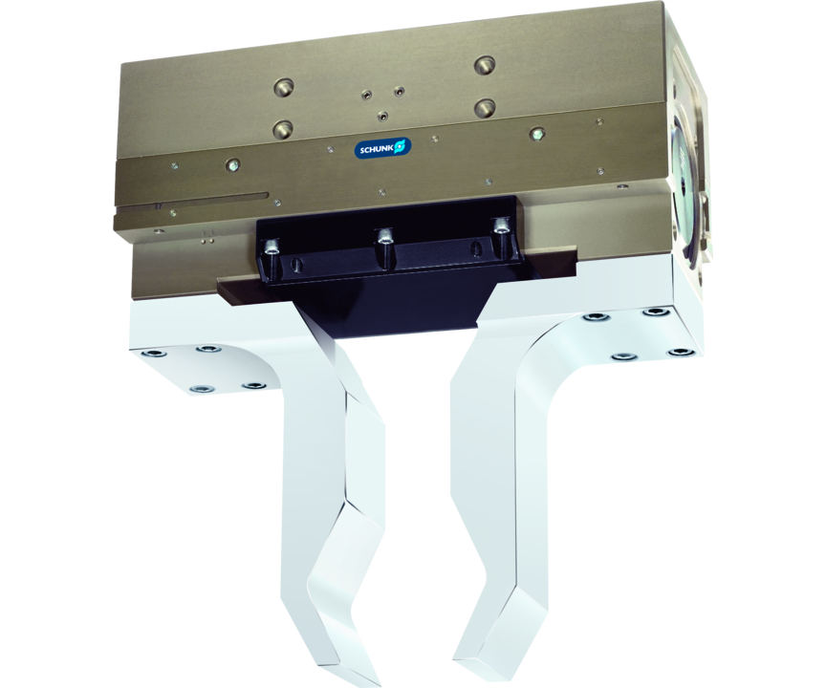
Heavy-load gripper
Sturdy 2-finger parallel gripper for heavy components and a broad part range, equipped with robust guides

Slide 3

Strong. Robust. Flexible.

Slide 4
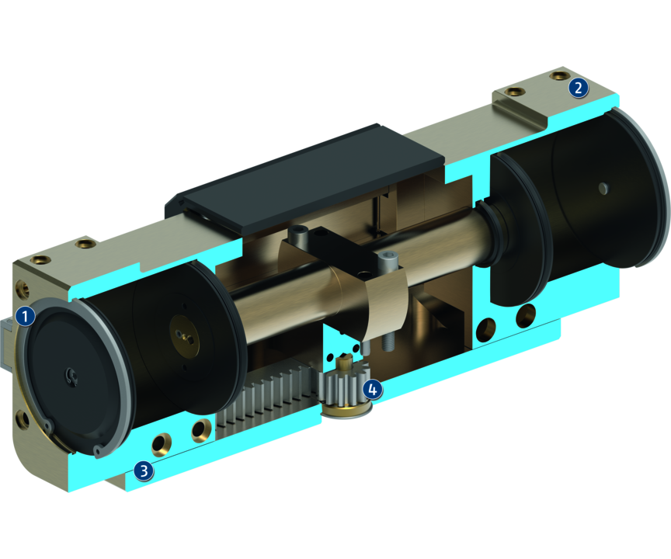
Principle of function
Functional description
The aligned base jaws are actuated with compressed air directly by the fixed piston, which opens and closes them.
The base jaws are synchronized by the rack and pinion kinematics.
The direct flow of force enables a high degree of efficiency and therefore very high gripping forces.
1
Sliding guide
2
Base Jaw
3
Housing
4
Kinematics

Slide 5
Advantages – Your benefits
Robust sliding guide for precise handling
High maximum moments possible suitable for using long gripper fingers
High efficiency through direct drive
Mounting from three gripper sides in three screw directions for universal and flexible gripper assembly
Air supply via hose-free direct connection or screw connections for flexible pressure supply in all automated systems

Slide 6
Technical data
Technical data overview
Size | Stroke per jaw | Closing force | Opening force | Recommended workpiece weight | Weight | Max. permissible finger length
 | [mm] | [N] | [N] | [kg] | [kg] | [mm]
100 | 100 | 10000 | 11480 | 50 | 35 | 500

