Slide 1

Product presentation
PSH
Long-stroke gripper

Slide 2
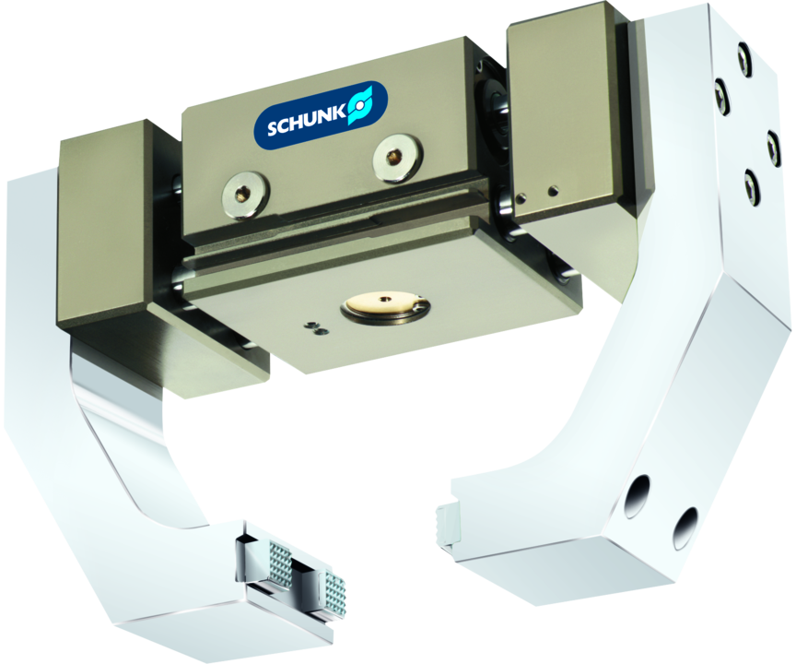
Long-stroke gripper
2-finger parallel gripper with long jaw stroke and dirt-resistant round guidance

Slide 3

Compact. Flexible. Fully encapsulated.

Slide 4
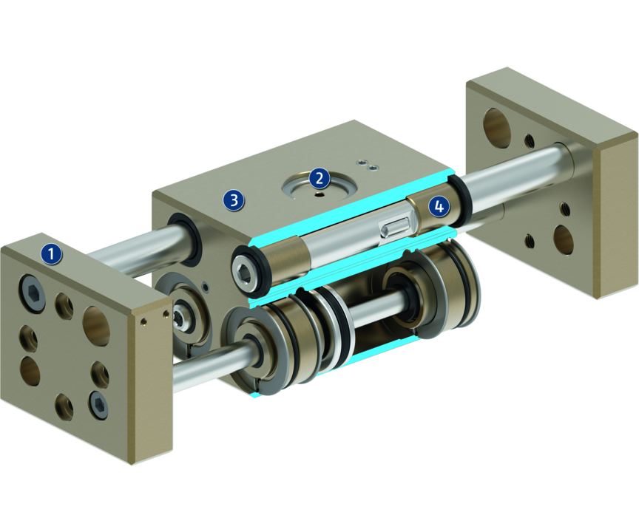
Principle of function
Functional description
By actuating the pistons with compressed air, the base jaws, which are located at the piston and the rack, are moved.
The jaw stroke is synchronized by means of rack and pinion kinematics.
1
Base Jaw
2
Kinematics
3
Housing
4
Round guidances

Slide 5
Advantages – Your benefits
High maximum moments possible suitable for using long gripper fingers
Dirt-protected round guidances sealed, for long strokes
Fastening at two gripper sides with centering for universal and flexible gripper assembly
Air supply via hose-free direct connection or screw connections for flexible pressure supply in all automated systems
Comprehensive sensor accessory program for versatile querying possibilities and stroke position monitoring

Slide 6
Technical data
Technical data overview
Size | Stroke per jaw | Closing force | Opening force | Recommended workpiece weight | Weight | Max. permissible finger length
 | [mm] | [N] | [N] | [kg] | [kg] | [mm]
22 | 14 .. 28 | 320 | 320 | 1.6 | 0.77 .. 0.95 | 140
32 | 22.5 .. 35 | 750 | 750 | 3.75 | 1.8 .. 2.05 | 170
42 | 29 .. 100 | 1170 | 1170 | 6 | 3.9 .. 6.7 | 230
52 | 64 | 1760 | 1760 | 8.8 | 8.05 | 300

