Slide 1

Product presentation
PFH
Long-stroke gripper

Slide 2
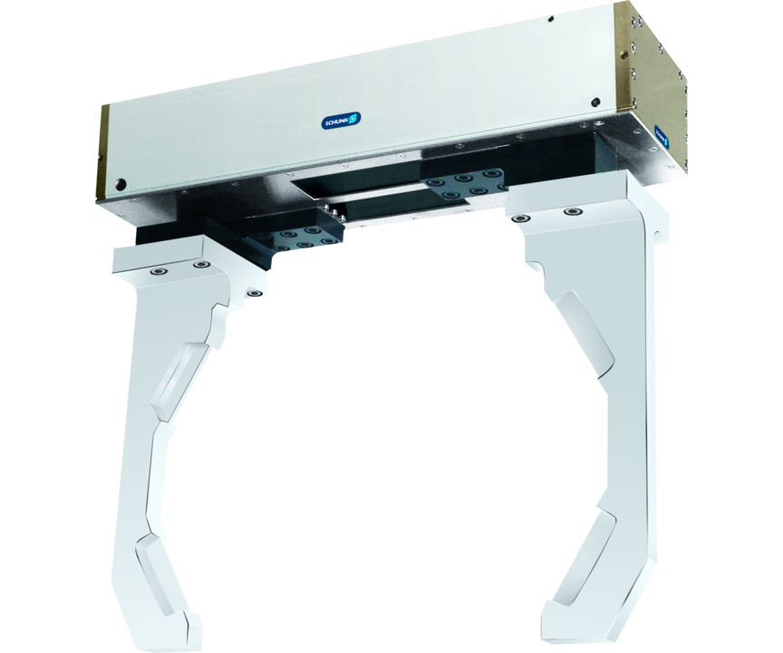
Long-stroke gripper
2-finger parallel gripper with long jaw stroke for large parts and/or a broad range of parts

Slide 3

Loadable. Flexible. Reliable.

Slide 4
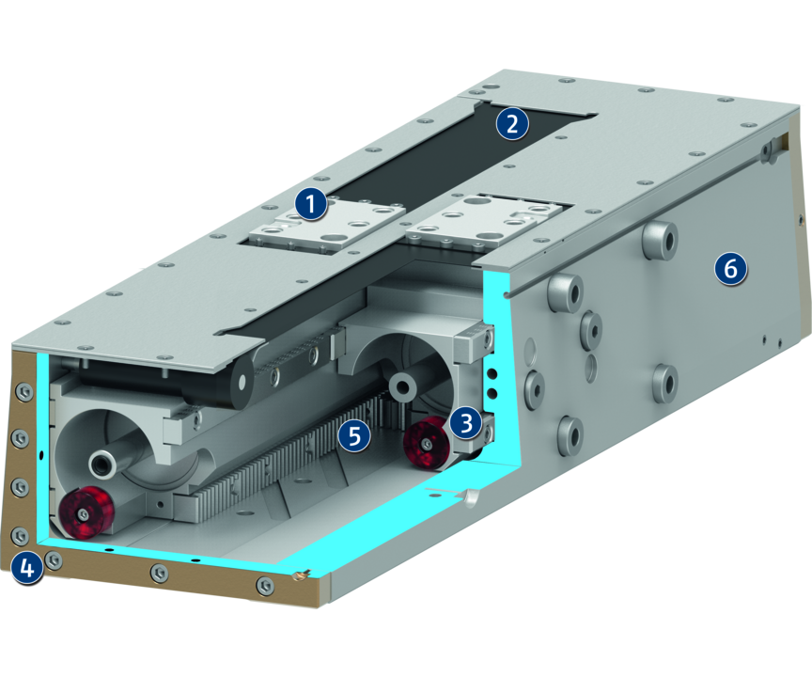
Principle of function
Functional description
The base jaws form the piston chambers while the pistons themselves remain stationary.
By pressure actuating opposing piston area, the base jaws set in motion.
The end of the stroke is dampened with an elastomer pad.
1
Base Jaw
2
Dust cover
3
Sliding guide
4
Centering and mounting possibilities
5
Kinematics
6
Housing

Slide 5
Advantages – Your benefits
Robust sliding guide for the precise handling of different workpieces
High maximum moments possible suitable for using long gripper fingers
Double piston rack and pinion principle for centric clamping
Mounting from two sides in three screw directions for universal and flexible gripper assembly
Air supply via hose-free direct connection or screw connections for flexible pressure supply in all automated systems

Slide 6
Technical data
Technical data overview
Size | Stroke per jaw | Closing force | Opening force | Recommended workpiece weight | Weight | Max. permissible finger length
 | [mm] | [N] | [N] | [kg] | [kg] | [mm]
150 | 150 | 2120 | 2120 | 11.2 | 18.9 | 450
200 | 200 | 2120 | 2120 | 11.2 | 23.5 | 600
250 | 250 | 2120 | 2120 | 11.2 | 28.6 | 750
300 | 300 | 2120 | 2120 | 14.7 | 33.6 | 900

