Slide 1

Product presentation
PFH-mini
Long-stroke gripper

Slide 2
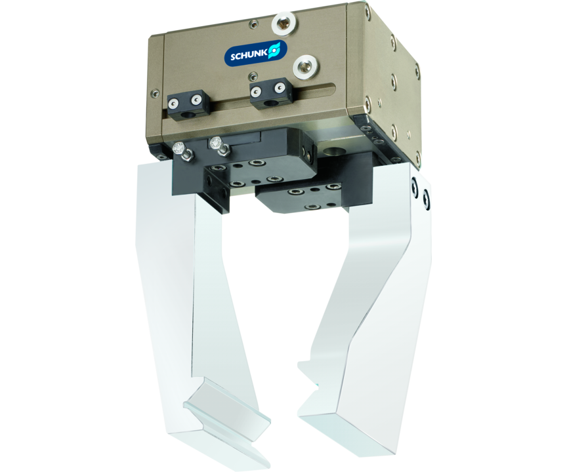
Long-stroke gripper
2-finger parallel gripper with long jaw stroke for large parts and/or a broad range of parts

Slide 3

Loadable. Flexible. Reliable.

Slide 4
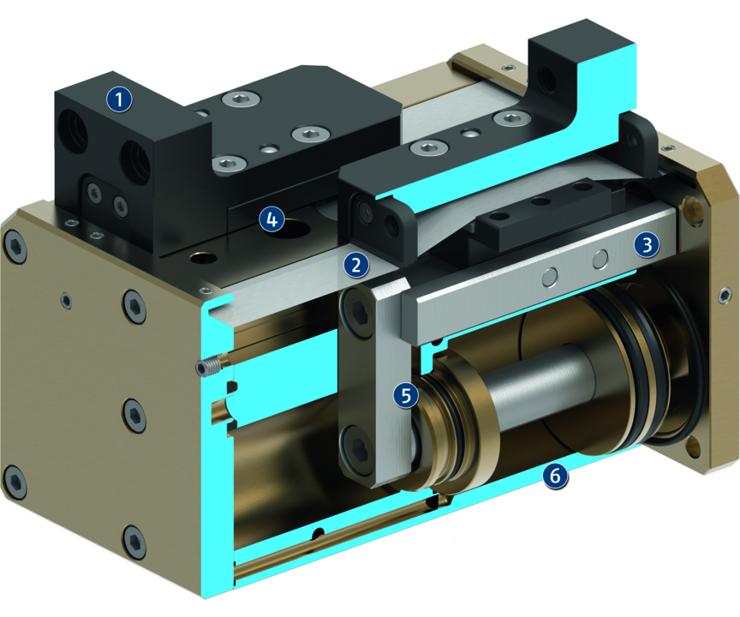
Principle of function
Functional description
By pressure actuation of the opposing piston, the base jaws, everyone is guided by a carrier on the piston, are set in motion.
The jaw stroke is synchronized by means of rack and pinion kinematics.
1
Base Jaw
2
Dust cover
3
Sliding guide
4
Centering and mounting possibilities
5
Kinematics
6
Housing

Slide 5
Advantages – Your benefits
Robust sliding guide for the precise handling of different workpieces
High maximum moments possible suitable for using long gripper fingers
Double piston rack and pinion principle for centric clamping
Mounting from two sides in three screw directions for universal and flexible gripper assembly
Air supply via hose-free direct connection or screw connections for flexible pressure supply in all automated systems

Slide 6
Technical data
Technical data overview
Size | Stroke per jaw | Closing force | Opening force | Recommended workpiece weight | Weight | Max. permissible finger length
 | [mm] | [N] | [N] | [kg] | [kg] | [mm]
30 | 30 .. 60 | 630 .. 720 | 570 | 3.15 | 2.65 .. 3.5 | 100 .. 150
40 | 40 .. 80 | 1260 .. 1540 | 1100 .. 1380 | 5.5 .. 6.3 | 4.6 .. 6.2 | 150 .. 200
50 | 50 .. 100 | 2600 .. 2950 | 2330 .. 2680 | 11.65 .. 13 | 9.6 .. 12.6 | 200 .. 250

