Slide 1

Product presentation
PGB
Universal gripper

Slide 2
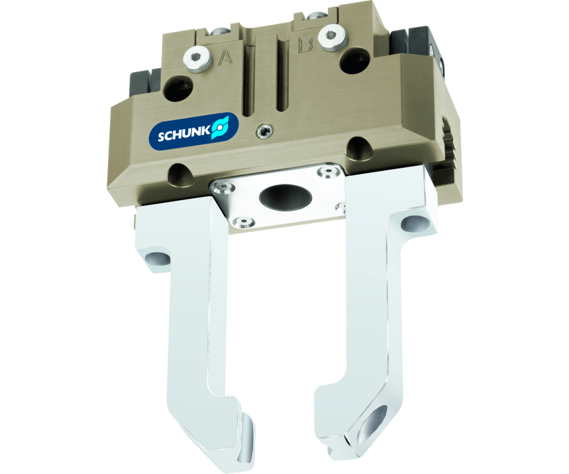
Universal gripper
Universal 2-finger parallel gripper with a high gripping force and high moment capacity due to the multi-tooth slideway as well as the center bore

Slide 3

Flexible. Loadable. Reliable.

Slide 4
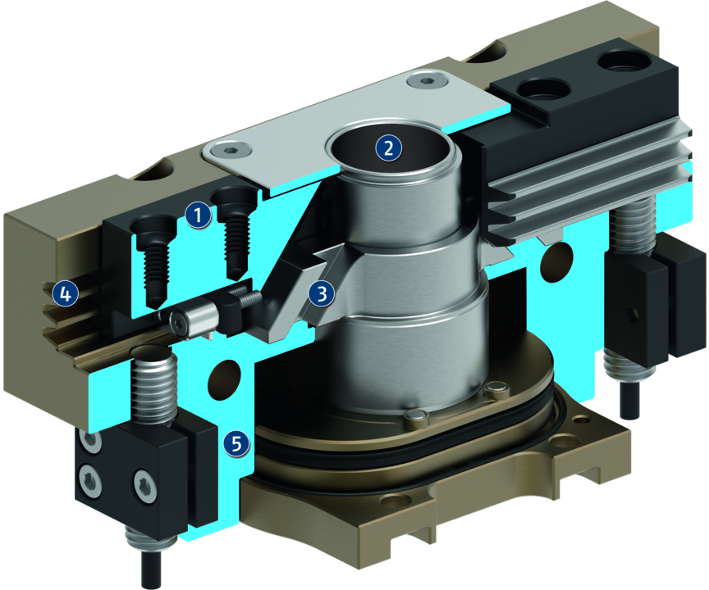
Principle of function
Functional description
The oval piston is moved up or down by compressed air.
The angled active surfaces of the wedge-hook produce a synchronized, parallel jaw motion.
1
Base Jaw
2
Center bore
3
Wedge-hook design
4
Multi-tooth guidance
5
Housing

Slide 5
Advantages – Your benefits
Robust multi-tooth guidance for precise handling
Center through-hole for feed-through of workpieces, supply hoses, sensor systems, optical workpiece recognition systems, etc.
High maximum moments possible suitable for using long gripper fingers
Drive concept oval piston for maximum gripping forces
Mounting from two sides in three screw directions for universal and flexible gripper assembly
Air supply via hose-free direct connection or screw connections for flexible pressure supply in all automated systems
Comprehensive sensor accessory program for versatile querying possibilities and stroke position monitoring

Slide 6
Technical data
Technical data overview
Size | Stroke per jaw | Closing force | Opening force | Recommended workpiece weight | Weight | Max. permissible finger length
 | [mm] | [N] | [N] | [kg] | [kg] | [mm]
64 | 4 | 90 | 110 | 0.7 | 0.28 | 64
80 | 6 | 230 | 260 | 1.25 | 0.47 | 80
100 | 8 | 370 | 410 | 2.1 | 0.78 | 100
125 | 10 | 590 | 640 | 3.3 | 1.32 | 125

