Slide 1

Product presentation
PGF
Universal gripper

Slide 2
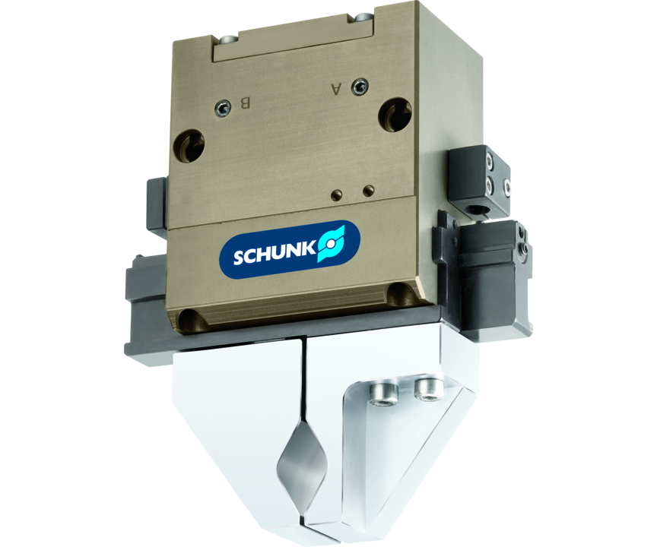
Universal gripper
Universal parallel gripper with surface-guided base jaws

Slide 3

Flexible. Compact. Robust.

Slide 4
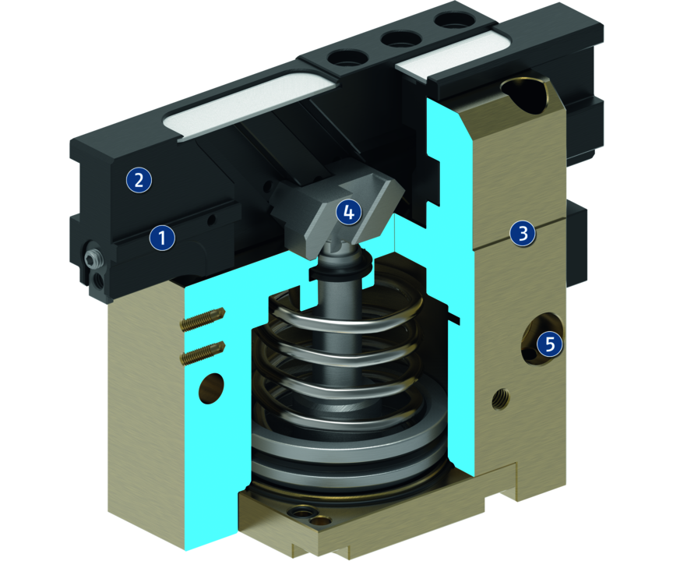
Principle of function
Functional description
The round piston is pushed upwards or downwards with compressed air.
The angled active surfaces of the wedge-hook produce a synchronized, parallel jaw motion.
1
Sliding guide
2
Base Jaw
3
Housing
4
Wedge-hook design
5
Centering and mounting possibilities

Slide 5
Advantages – Your benefits
Precise flat guidance for very good guidance characteristics
Large stroke at compact design for minimal interfering contours
Mounting from two sides in three screw directions for universal and flexible gripper assembly
Air supply via hose-free direct connection or screw connections for flexible pressure supply in all automated systems
M5 connection on both sides of the guidances for the use of lubricating nipples

Slide 6
Technical data
Technical data overview
Size | Stroke per jaw | Closing force | Opening force | Recommended workpiece weight | Weight | Max. permissible finger length
 | [mm] | [N] | [N] | [kg] | [kg] | [mm]
50 | 7.5 | 240 .. 340 | 260 .. 360 | 1.2 | 0.3 .. 0.35 | 50
64 | 11.5 | 360 .. 480 | 380 .. 500 | 1.8 | 0.6 .. 0.7 | 64
80 | 16.5 | 560 .. 760 | 590 .. 790 | 2.8 | 1.15 .. 1.25 | 80
100 | 23.5 | 880 .. 1150 | 900 .. 1170 | 4.4 | 2.35 .. 2.85 | 100
125 | 31.5 | 1420 .. 1900 | 1490 .. 1970 | 7.1 | 5 .. 5.3 | 125

