Slide 1

Product presentation
KGG
Gripper for small components

Slide 2
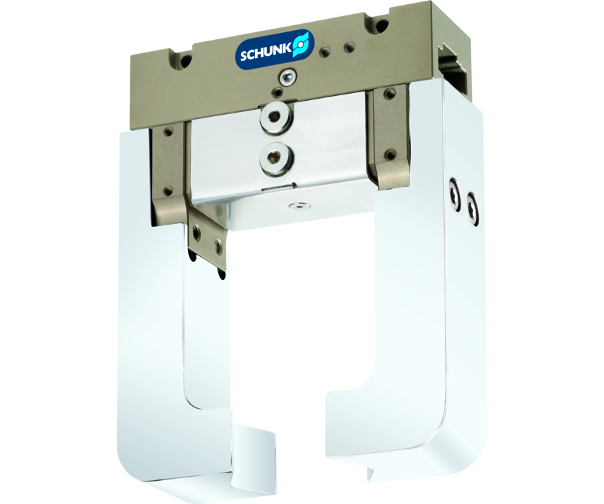
Gripper for small components
Narrow 2-finger parallel gripper with large stroke
The SCHUNK gripper with the largest stroke for the range of small-sized parts.
Up to 60 mm stroke per finger

Slide 3

Compact. Flexible. Slim.

Slide 4
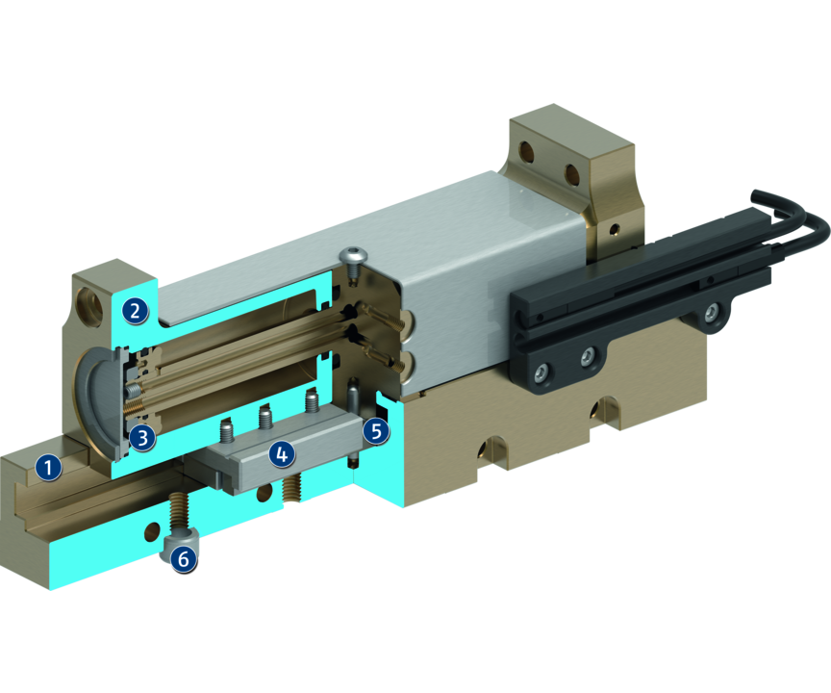
Principle of function
Functional description
The aligned base jaws are actuated with compressed air directly by the fixed piston, which opens and closes them.
The base jaws are synchronized by the internal rack and pinion arrangement.
1
Housing
2
Base Jaw
3
Drive
4
Sliding guide
5
Kinematics
6
Centering and mounting possibilities

Slide 5
Advantages – Your benefits
Robust T-slot guidance for high maximum moments
Pneumatic 2-piston drive design for direct power transmission and high efficiency
Rack and pinion principle for centric clamping
Mounting from two sides in three screw directions for universal and flexible gripper assembly
Air supply via hose-free direct connection or screw connections for flexible pressure supply in all automated systems

Slide 6
Technical data
Technical data overview
Size | Stroke per jaw | Closing force | Opening force | Recommended workpiece weight | Weight | Max. permissible finger length
 | [mm] | [N] | [N] | [kg] | [kg] | [mm]
60 | 10 .. 20 | 45 | 53 | 0.23 | 0.09 .. 0.11 | 40
70 | 12 .. 24 | 63 | 85 | 0.32 | 0.15 .. 0.19 | 50
80 | 15 .. 30 | 130 | 165 | 0.66 | 0.25 .. 0.33 | 80
100 | 20 .. 40 | 175 | 220 | 0.9 | 0.37 .. 0.5 | 80
140 | 30 | 260 | 300 | 1.3 | 0.77 | 100
220 | 45 | 390 | 515 | 1.95 | 2 | 130
280 | 60 | 540 | 670 | 2.7 | 4.2 | 160

