Slide 1

Product presentation
KTG
Gripper for small components

Slide 2
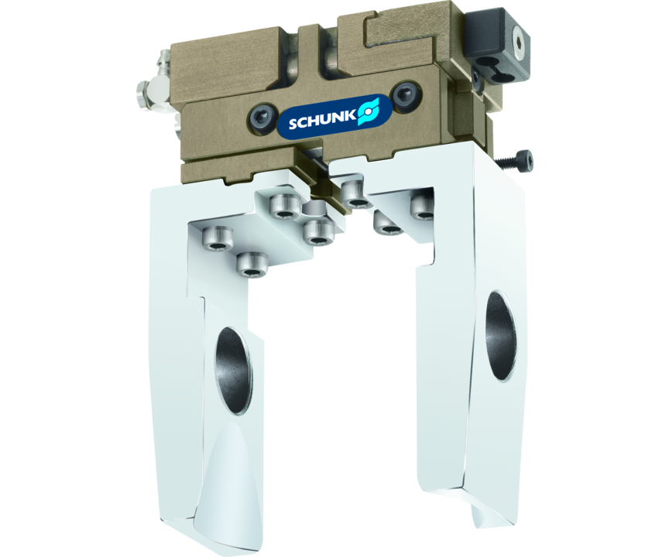
Gripper for small components
2-finger parallel gripper with center bore

Slide 3

Compact. Cost-effective. Flexible.

Slide 4
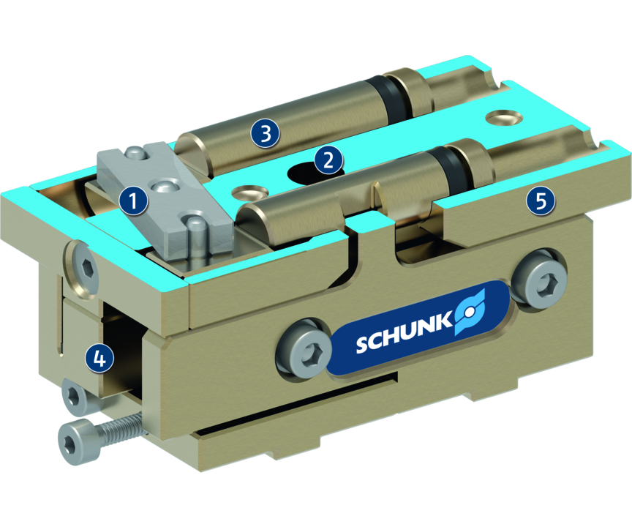
Principle of function
Functional description
By pressurizing the first or second piston, the base jaws which are individually guided by a carrier on the piston, are moved.
The movement is synchronized by means of lever kinematics.
1
Kinematics
2
Center bore
3
Drive
4
Profiled rail guide
5
Housing

Slide 5
Advantages – Your benefits
Low weight for weight-optimized handling solutions
Long stroke in proportion to the size
Base jaws guided on roller bearings for precise gripping
Center through-hole for workpiece feeding, sensor systems or actuators
Air supply via hose-free direct connection or screw connections for flexible pressure supply in all automated systems

Slide 6
Technical data
Technical data overview
Size | Stroke per jaw | Closing force | Opening force | Recommended workpiece weight | Weight | Max. permissible finger length
 | [mm] | [N] | [N] | [kg] | [kg] | [mm]
50 | 4.5 | 13 | 13 | 0.07 | 0.08 | 50

