Slide 1

Product presentation
PGN-plus
Universal gripper

Slide 2
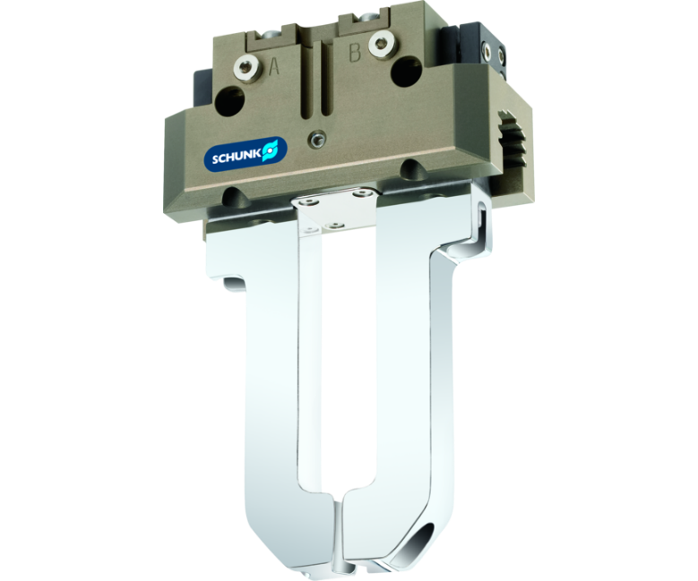
Universal gripper
Universal 2-finger parallel gripper with a high gripping force and high maximum moments due to the use of a multi-tooth guidance
The world's best selling universal gripper

Slide 3

Reliable. Robust. Flexible.

Slide 4
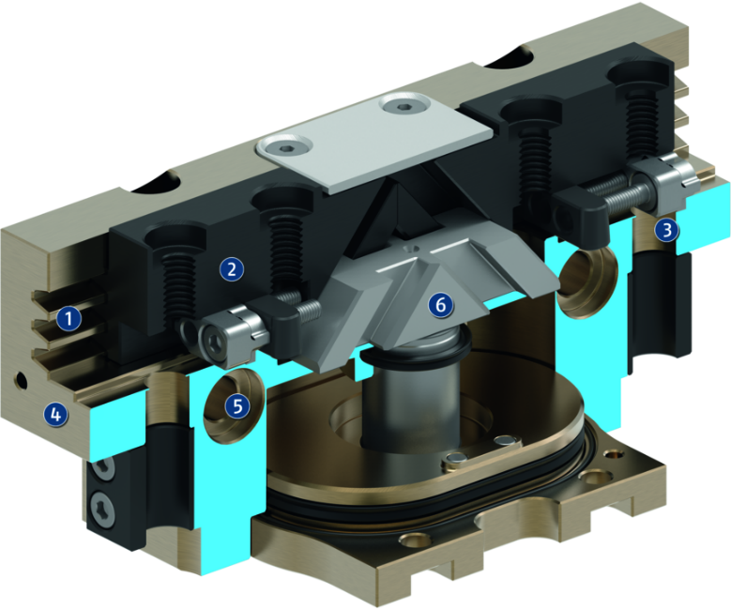
Principle of function
Functional description
The oval piston is moved up or down by compressed air.
The angled active surfaces of the wedge-hook produce a synchronized, parallel jaw motion.
1
Multi-tooth guidance
2
Base Jaw
3
Sensor system
4
Housing
5
Centering and mounting possibilities
6
Wedge-hook design

Slide 5
Advantages – Your benefits
Robust multi-tooth guidance for precise handling
High maximum moments possible suitable for using long gripper fingers
Drive concept oval piston for maximum gripping forces
Mounting from two sides in three screw directions for universal and flexible gripper assembly
Air supply via hose-free direct connection or screw connections for universal and flexible gripper assembly
Comprehensive sensor accessory program for versatile querying possibilities and stroke position monitoring
Compact dimensions for minimal interfering contours in handling
Manifold options for special optimization for your specific case of application (dustproof, high-temperature, corrosion-protected, etc.)

Slide 6
Technical data
Technical data overview
Size | Stroke per jaw | Closing force | Opening force | Weight | Recommended workpiece weight | Max. permissible finger length
 | [mm] | [N] | [N] | [kg] | [kg] | [mm]
40 | 2.5 | 123 .. 235 | 132 .. 254 | 0.08 .. 0.13 | 0.62 | 50 .. 58
50 | 2 .. 4 | 135 .. 467 | 145 .. 503 | 0.17 .. 0.26 | 0.7 .. 1.45 | 50 .. 72
64 | 3 .. 6 | 250 .. 855 | 270 .. 925 | 0.28 .. 0.44 | 1.25 .. 2.6 | 64 .. 90
80 | 4 .. 8 | 415 .. 1410 | 465 .. 1570 | 0.5 .. 0.75 | 1.78 .. 4.3 | 80 .. 110
100 | 5 .. 10 | 660 .. 2235 | 725 .. 2445 | 0.81 .. 1.3 | 3.3 .. 6.85 | 100 .. 145
125 | 6 .. 13 | 1080 .. 3955 | 1170 .. 4110 | 1.35 .. 2.3 | 5.4 .. 11.2 | 125 .. 180
160 | 8 .. 16 | 1640 .. 5260 | 1770 .. 5685 | 2.6 .. 4.4 | 8.2 .. 16 | 125 .. 220
200 | 14 .. 25 | 2700 .. 7768 | 2870 .. 8322 | 5.4 .. 9 | 13.5 .. 23.5 | 160 .. 280
240 | 17 .. 30 | 4200 .. 8340 | 4440 .. 8710 | 8.5 .. 12.6 | 21.5 .. 33 | 240 .. 320
300 | 20 .. 35 | 6000 .. 12500 | 6260 .. 13000 | 13.9 .. 18.2 | 30 .. 51.5 | 250 .. 350
380 | 26 .. 45 | 9050 .. 21150 | 9400 .. 21800 | 28 .. 39.5 | 47 .. 80.5 | 300 .. 400

