Slide 1

Product presentation
LM
Stroke module

Slide 2
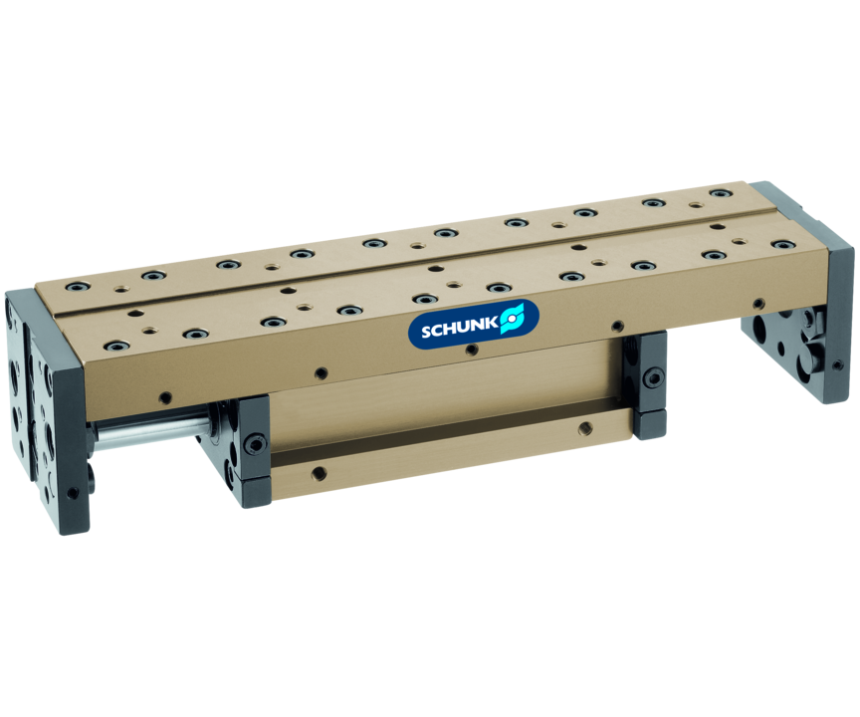
Stroke module
Linear module with pneumatic drive and pre-loaded crossed roller bearings, free from play in dovetail rails
The pneumatic linear module with the most diverse fields of applications for assembly automation.
52 stroke variants with up to 450 mm nominal stroke

Slide 3

Reliable. Precise. Modular.

Slide 4
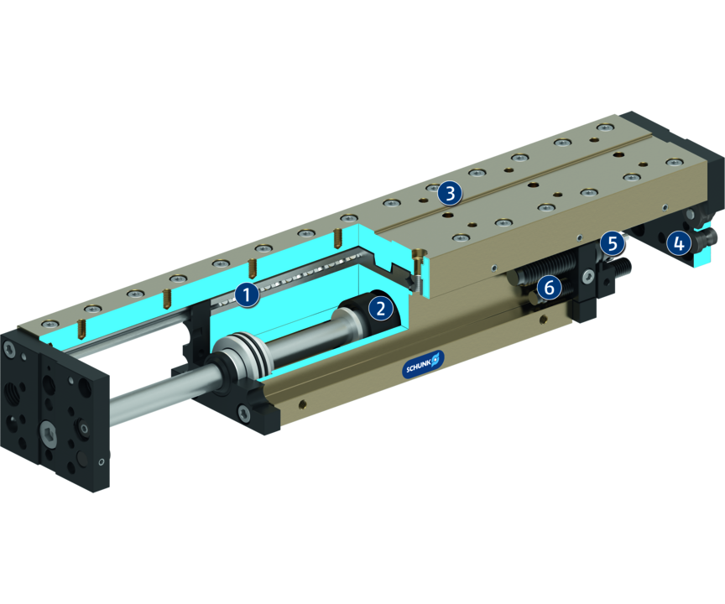
Principle of function
Functional description
The slide is guided with pretensioned crossed rollers at the base body and driven with a double-acting pneumatic cylinder which is integrated in the base body.
1
Cross roller guidance
2
Drive
3
Mounting pattern
4
Damping adjustment
5
End position adjustability
6
Sensor system

Slide 5
Advantages – Your benefits
Closed slide construction for high rigidity
Shock absorbers and proximity switches integrated in the projecting surfaces for vibration-free movements and end position monitoring
Compact dimensions for minimum interfering contours of the entire system
Pretensioned junction rollers That means absolutely scope-free
High basic load ratings in all load directions
Several intermediate positions possible for maximum flexibility in applications
Standardized mounting bores for numerous combinations with other components from the modular system
Rod lock by means of clamping cartridge for safety in case of emergency stops

Slide 6
Technical data
Technical data overview
Size | Stroke | extend force | retracted force | Weight
 | [mm] | [N] | [N] | [kg]
25 | 25 .. 59 | 67 | 50 | 0.44 .. 0.6
50 | 13 .. 100 | 120 | 103 | 0.88 .. 1.45
100 | 25 .. 225 | 294 | 226 | 1.9 .. 4.78
200 | 25 .. 350 | 482 | 415 | 3.9 .. 10.59
300 | 25 .. 450 | 753 | 633 | 4.85 .. 15.81

